Slide 1
Scalable Time Series Similarity Search for Data Analytics
Patrick Schäfer, Zuse-Institut Berlin
06.05.2015

Slide 2
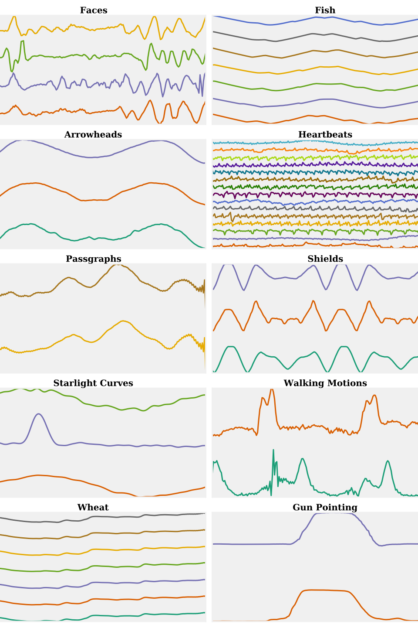
Time Series
Time series are a collection of values sequentially recorded over time.
Time series are recorded in business, medical and scientific databases.
May constitute large databases.
Data analytics based on similarity is the tool for exploring these databases.

Slide 3
Similarity
Bells
A human has an intuitive understanding of the similarity of two objects (time series):
Extract an abstract shape from the time series and
Cylinders
Funnels

Slide 4
Similarity
Bells
A human has an intuitive understanding of the similarity of two objects (time series):
Extract an abstract shape from the time series and
Compare the similarity of the abstract patterns.
Cylinders
Funnels

Slide 5
Similarity
Representation
Bells
At the core of each data analytics task there is a
time series representation and
a similarity measure/model to compare two time series.
Similarity Measure/
Model
Cylinders
Funnels

Slide 6
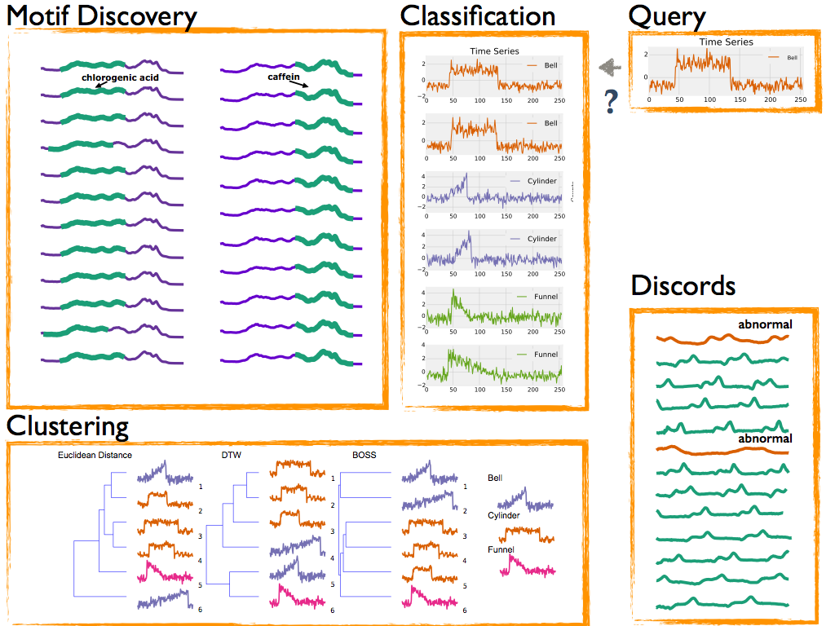
Data Analytics Tasks
Classification
Clustering
Motif Discovery
Anomaly Detection
Query by content

Slide 7
Motivation 1/2
Raw walking
motion data
Aligned patterns of
fixed size
preprocessing
Commonly performed by a human domain expert!

Slide 8
Motivation 1/2
Research assumes preprocessed datasets:
In most publications datasets were preprocessed by domain experts. This does not scale.
The key challenge is to provide a similarity measure and a time series representation that are alignment-free and deal with erroneous and extraneous (noisy) data.

Slide 10
Motivation 2/2
Research focusses on accuracy:
„A new algorithm is of interest in terms of accuracy if it can significantly outperform 1-NN Dynamic Time Warping (DTW)”
Consensus: 1-NN DTW is among the best classifiers and the benchmark to compare to.
1-NN DTW takes hours to days for moderately sized datasets of O(N^3) time series.
The key challenge is to provide scalability in train and test times while maintaining high accuracy.

Slide 11
Time Series Representations
Symbolic Fourier Approximation (SFA), EDBT 2012.

Slide 12
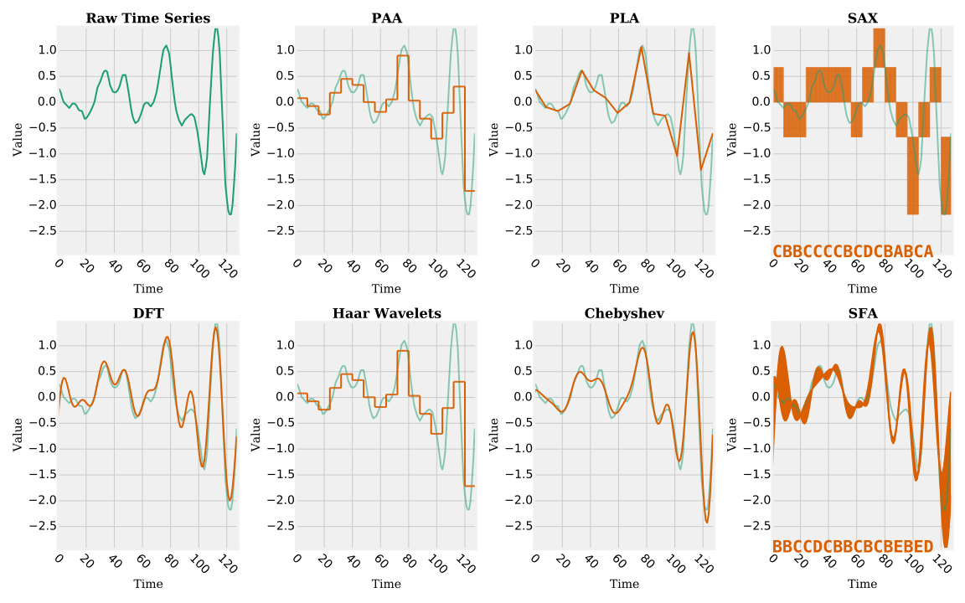
„Zitat hier eingeben.“
–Christian Bauer

Slide 13
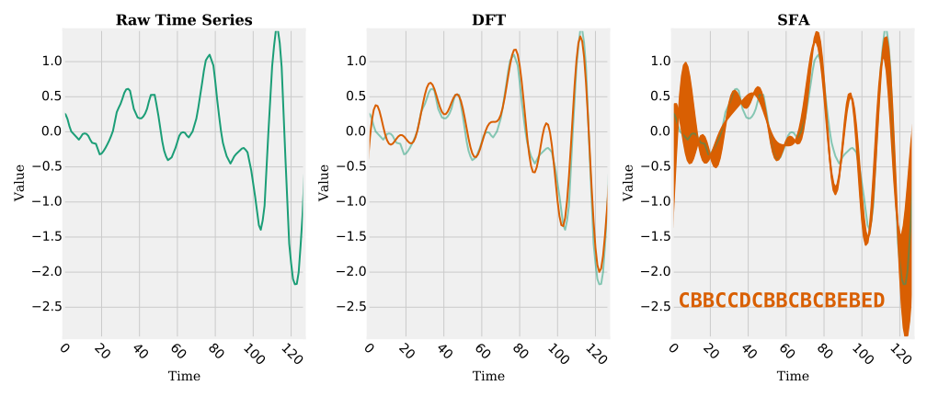
Symbolic Fourier Approximation (SFA)
SFA represents each real valued time series by a sequence of symbols, using a finite alphabet.
SFA is composed of
approximation using the Fourier transform and
quantization using Multiple Coefficient Binning.

Slide 14
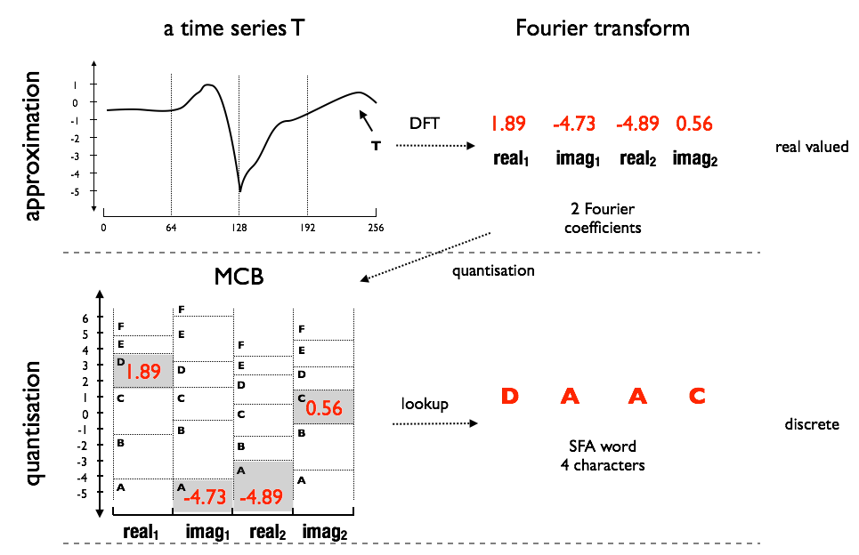
Symbolic Fourier Approximation

Slide 15
Properties of SFA
Noise removal
Using the Fourier transform (low-pass filter) and quantization.
String representation
Frequency Domain
Dimensionality Reduction
Storage reduction

Slide 16
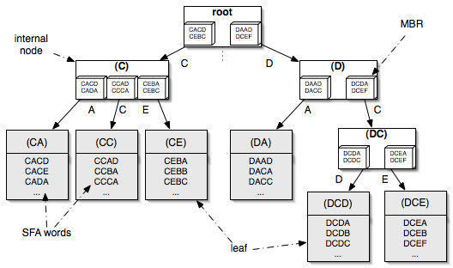
Properties of SFA
Noise removal
String representation
Allows for string matching algorithms like hashing or the bag of words to be applied, and has a noise reducing effect.
Frequency Domain
Dimensionality Reduction
Storage reduction

Slide 17
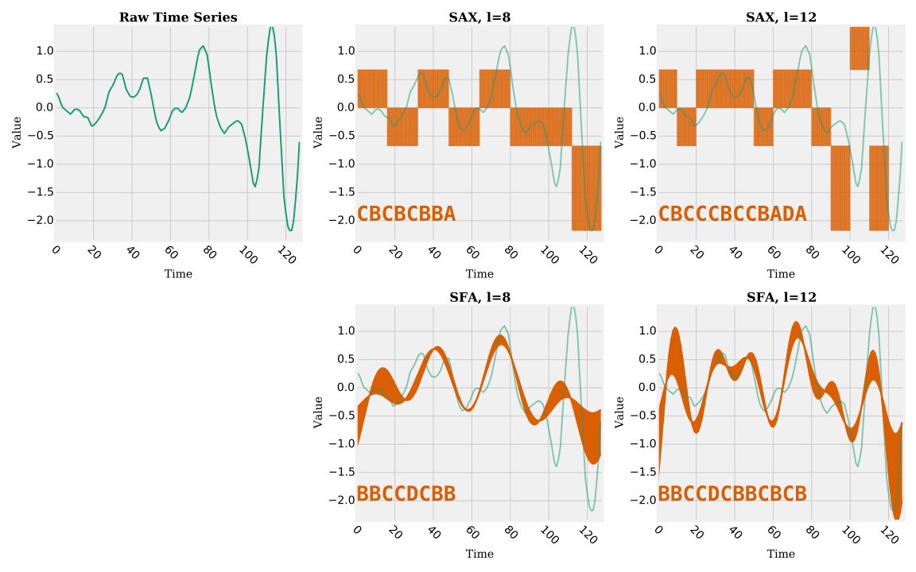
Properties of SFA
Noise removal
String representation
Frequency Domain
The SFA word length can be incrementally adapted by choosing an arbitrary subset of Fourier coefficients without recalculating the Fourier transform.
Dimensionality Reduction
Storage reduction

Slide 18
Properties of SFA
Noise removal
String representation
Frequency Domain
Dimensionality Reduction
To postpone the Curse of Dimensionality approximation is applied prior to indexing.
Storage reduction

Slide 19
Properties of SFA
128 x 64-Bit
16 x 64-Bit
16 x 2-Bit
Noise removal
String representation
Frequency Domain
Dimensionality Reduction
Storage reduction
SFA has a by up to a factor of O(10³) lower memory foot- print than the original time series by the use of (a) approximation and (b) quantization.

Slide 20
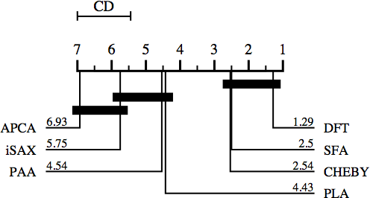
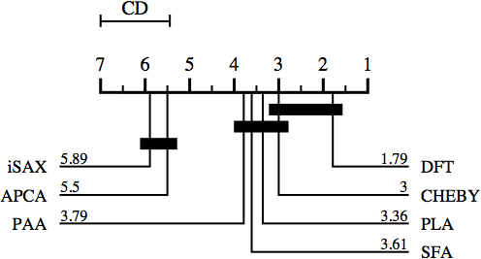
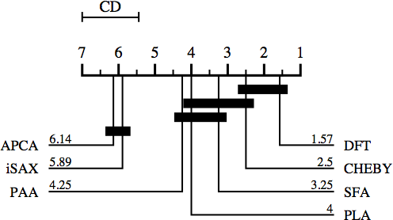
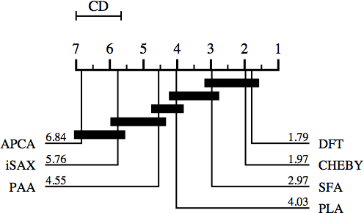
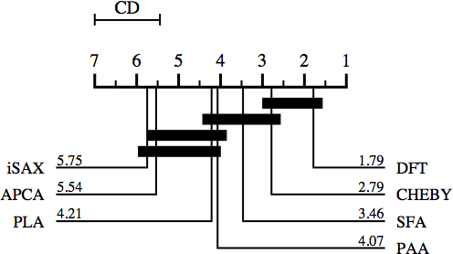
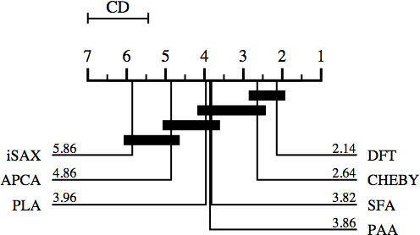
Experiments: Critical distance diagrams over the average ranks on 1-NN performance
n:256,l=4
n:256,l=8
n:256,l=16
n:512,l=4
n:512,l=8
n:512,l=16

Slide 21
SFA trie
Is a prefix tree over the SFA words.
Properties:
Controlled Fanout using Alphabet size.
Simple split criterion using next symbol.
Controlled depth limited by word length.
Allows for bulk loading.
Does not degenerate with length of the SFA words.

Slide 22
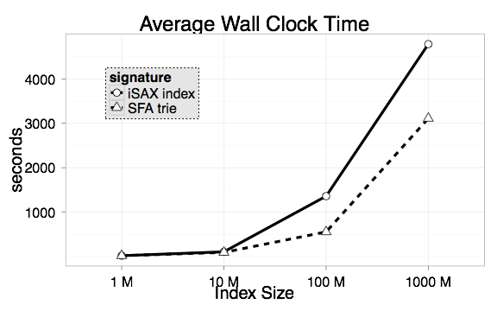
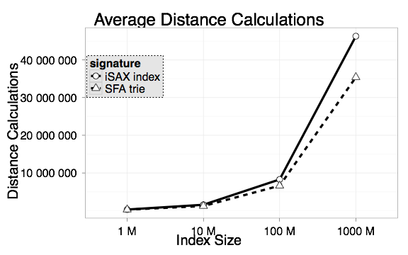
SFA trie vs iSAX index

Slide 23
Time Series Similarity Models
Shotgun Distance, MLDM 2014.
Bag-Of-SFA-Symbols (BOSS), DMKD 2014.
Bag-Of-SFA-Symbols in Vector Space (BOSS), Submitted 2015.

Slide 24
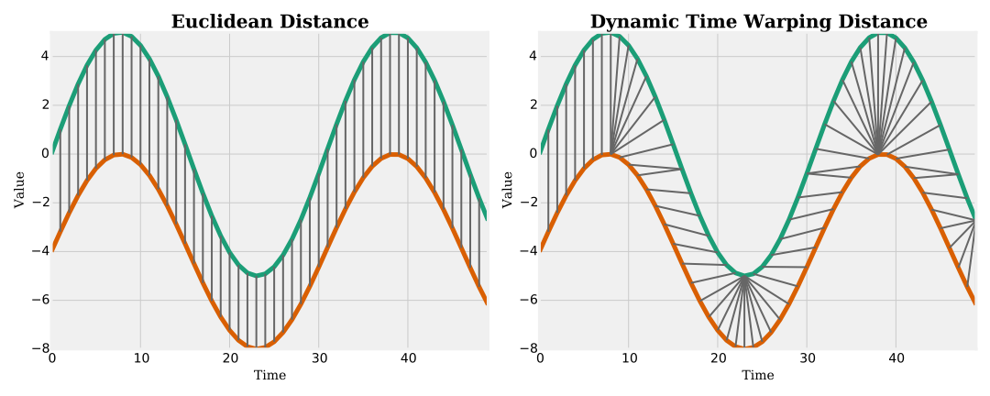
Time Series Similarity
Euclidean Distance
The similarity of two time series is commonly defined by a distance measure.
Two time series are similar, if they are within a small distance.
Common distance measures are:
Dynamic Time Warping (DTW)
Euclidean Distance (ED)
DTW

Slide 25
Raw Data

Slide 26
Raw Data
Shotgun Distance
alignment-free

Slide 27
Raw Data
Shotgun Distance
BOSS
alignment-free
+ noise-robust

Slide 28
Raw Data
Shotgun Distance
BOSS
BOSS VS
alignment-free
+ noise-robust
+ scalable

Slide 29
Shotgun Ensemble
Model & Distance
There is an over-dependence on preprocessed time series data to smoothen the data, and extract aligned and equal length patterns.
Idea: Align characteristic patterns like heartbeats in ECG signals or gait cycles in gait styles.

Slide 31
Disjoint Windows
find
label
1-NN Shotgun
Ensemble Distance
O(Nn²)

Slide 32
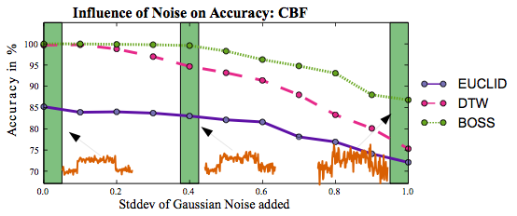
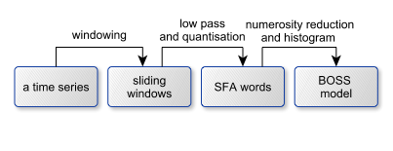
Bag-Of-SFA-Symbols (BOSS)
Raw time series data may be recorded at variable lengths, be noisy, or are composed of repetitive substructures.
Idea: Add robustness to noise
Low pass filter: Approximation
String Representation: Quantization

Slide 34
Bag of Patterns Model
Dataset
Euclidean
distance
1-NN BOSS
Distance
O(Nn)

Slide 35
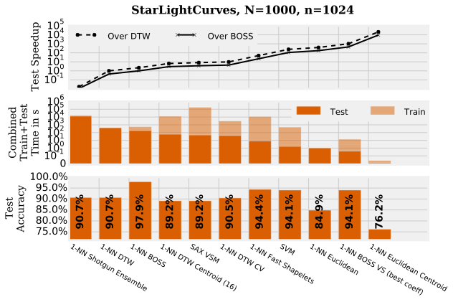
BOSS in Vector Space (BOSS VS)
Accurate classifiers have unreasonable train and test times.
Big Data and Real-time analytics require for fast train and test times.
Idea: build a model for each class as opposed to each time series.

Slide 36
Bag of Patterns model
Classes
cosine
similarity
1-NN BOSS VS
Distance
O(n)

Slide 37
Time Series Data Analytics

Slide 38
Time Series Classification
Model
Time series classification aims at assigning a class label to an unlabeled query time series based on a (trained) model.
Most simple classifier: 1-Nearest-Neighbor
Requires distance measure.
Accurate, parameter free, and train free, O(N).
find
label
Query

Slide 39
State of the Art Classifiers
Whole Matching
1-Nearest-Neighbor Dynamic Time Warping (Centroids)
1-Nearest-Neighbor Euclidean Distance (Centroids)
Matching Subsequences to Subsequences
Shapelets (Logical, Fast)
1-NN Shotgun Ensemble Distance
Ensemble Techniques
PROP
Symbolic Representations
Bag of Patterns
SAX VSM
Bag-Of-SFA-Symbols (BOSS)
Bag-Of-SFA-Symbols in Vector Space (BOSS VS)
Machine Learning Techniques
SVM
Random/Rotation Forest
…

Slide 40
Computational Complexity
 | Training | Testing
1-NN ED | - | O(Nn)
1-NN DTW | - | O(Nn²)
1-NN DTW CV | O(100Nn²) | O(Nnr)
SAX VSM | O(Nn³) | O(n) ?
Shapelets | O(N²n³) to O(Nn²) | O(n)
SVM | O(N²n) | O(n²)
Shotgun Distance | O(N²n³) | O(Nn²)
BOSS | O(N²n²) | O(Nn)
BOSS VS | O(Nn^{3/2}) | O(n)
N = #time series, n=length, r=warping window size

Slide 41
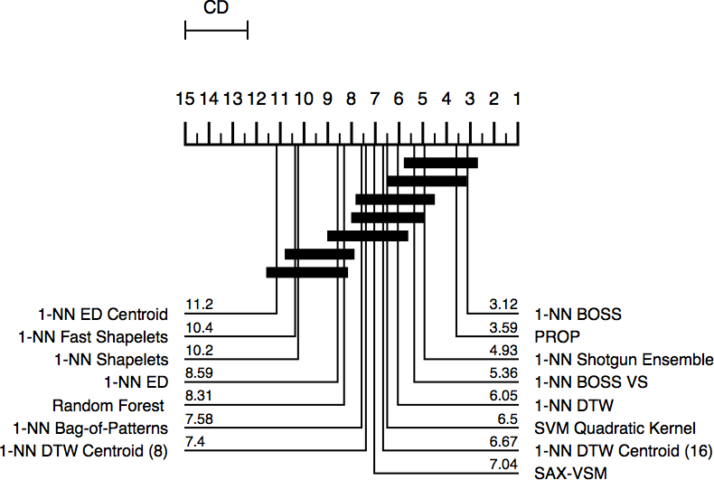
Classification Accuracy
Most accurate:
BOSS
PROP (Ensemble)
Shotgun Ensemble
BOSS VS
1-NN DTW

Slide 42
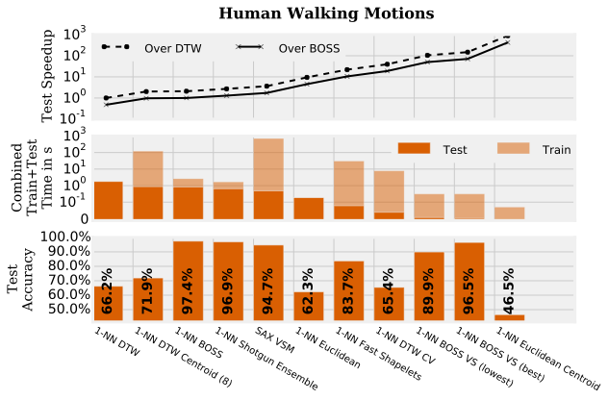
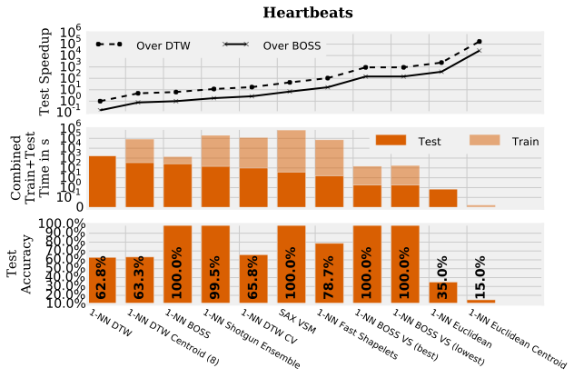
Fast with high accuracy:
BOSS VS
Highest accuracy:
BOSS

Slide 43
Time Series
Clustering
Aims at finding clusters / groups of similar time series.
Unsupervised (no labels given)
Typical algorithms: k-means, k-medoids, hierarchical clustering.

Slide 44
Most accurate: BOSS
Alignment-free and noise robust clustering.

Slide 45
Conclusion
BOSS VS:
fast train, test times, high accuracy.
SFA: tolerance to noise
Bag of Pattern: subsequence to subsequence matching
BOSS
most accurate
SFA: tolerance to noise
Bag of Pattern: subsequence to subsequence matching
Shotgun Ensemble
accurate
Raw data: no tolerance to noise
Subsequence to Subsequence matching

Slide 46
Thank you!

Slide 47
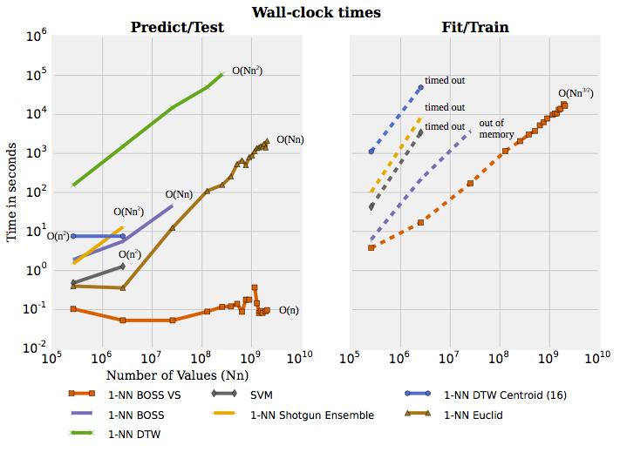
Scalability
8 billion values (15 GB)
Fastest test time:
Constant: BOSS VS
Fastest train time:
train free classifiers
BOSS VS

Slide 48
Properties of SFA
Noise removal
String representation
Frequency Domain
Dimensionality Reduction
Storage reduction

Slide 49
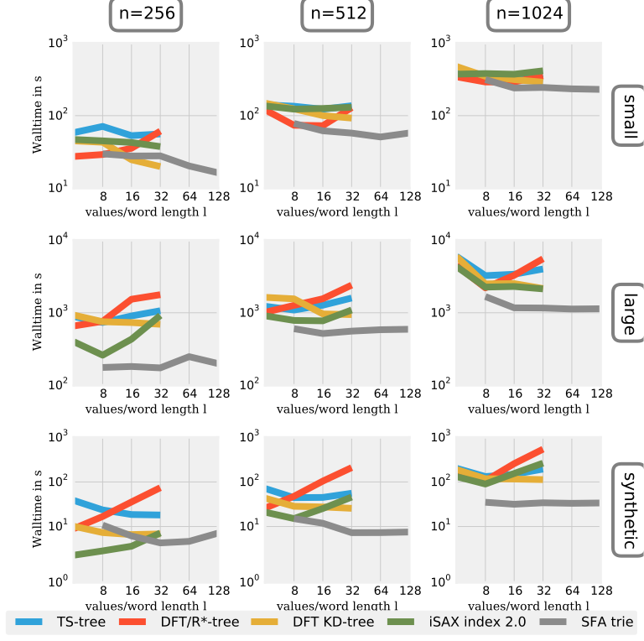
Scales with Dimensionality

Slide 50
