Slide 1
Polytechnic University of Tirana Faculty of Information Technology Computer Engineering Department
Identification of on-line users and Digital Signature
Marin Aranitasi Prof. Dr Betim Çiço

Slide 2
Content
Objectives
Overview of the Actual Security Problems
Proposal of my Solution
Description of Previous Solutions
Schematic View & Authentication Technologies
Detailed Work Description
Security Issues
Conclusions

Slide 3
Objectives
I will treat systems that offer services (especially public services)
E-government
All electronic systems that offer services, have one common element --- the identification & the authorization of their users.
Information exchange → username-password

Slide 4
Government services
Government to Citizen
Government to Business
Government to Government

Slide 5
Problems
Users have to remember a lot of identification elements
Users in case of a lost or in case they forget the id elements, have to go to the specific institution, with an official request ,to get back their id information.
Every institution has to create help desk structures, that in 80-90% face with issuance of id elements.
This mechanism of management has big problems because we can’t guarantee the authenticity of the operations with the electronics services, if the credentials are so “OPEN”

Slide 6
My proposal
To create a unified identification mechanism, which can be utilized from all electronic systems that are currently in use.
The real objective → The construction of a communication infrastructure, between electronic systems of different institutions, that allow the identification of the users.
PKI – Public Key Infrastructure

Slide 7
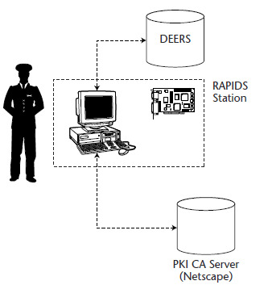
Previous PKI projects(1) Common Access Card(CAC)
DoD PKI-based security project
Defense Enrollment Eligibility Reporting System (DEERS)
Real-time Automated Personnel Identification System (RAPIDS),

Slide 8
Previous PKI projects(11) Common Access Card(CAC)
Three certificates stored on the CAC include the following:
An authentication certificate. - Accessing secure Web portals.
A signing certificate. – sign e-mail
An encryption certificate. - This certificate is used by others to send encrypted email to the CAC card owner
Combination of biometrics and PIN to protect access to the card.

Slide 9
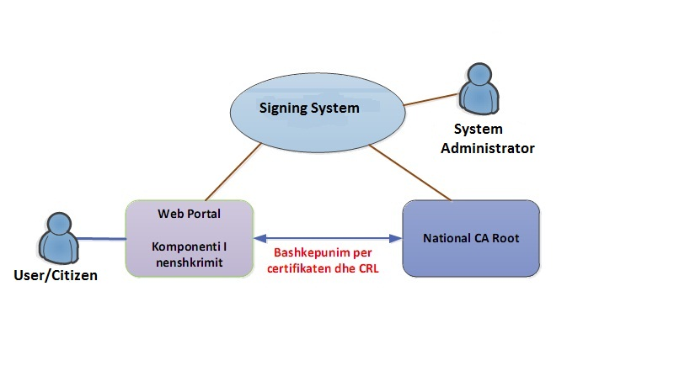
Schematic view

Slide 10
Schematic view
User/citizen
SCDev
Portal
National CA-Root
Signing System
System Administrator

Slide 11
Identification technologies
Something you know – username-password (single – factor authentication)
Something you have – media, token (two factor authentication)
Something you are – biometrics

Slide 12
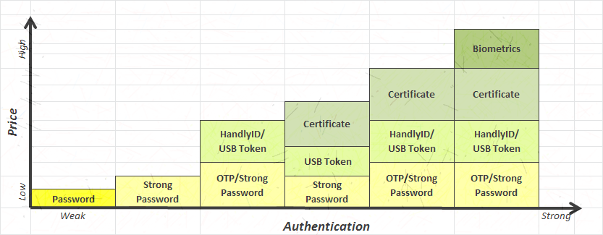
Price vs Authentication

Slide 13
Considerations
Identification techniques
Key - Fob
Smart cards
USB token
Performance /cost
Performance view
Cost view
Sociological view

Slide 14
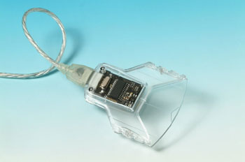
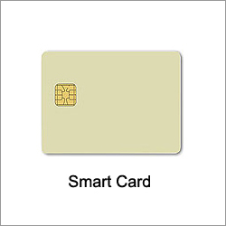
Smart cards
Choose smart – card
Relatively expensive
More
secure
manageable

Slide 15
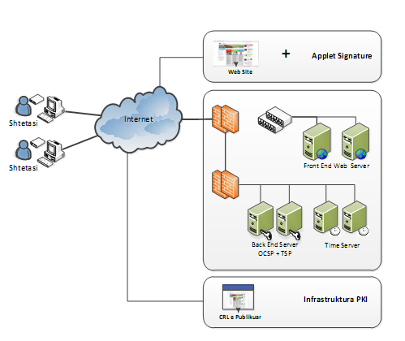
Detailed scheme

Slide 16
Detailed scheme
Portal (Website)
PKI Infrastructure
OCSP/TSP

Slide 17
PKI infrastructure
Servers :
Active directory server
Certificate server
Mail server
AD-SRV
Cert-SRV
CA
Mail-SRV
User/Citizen
Network

Slide 18
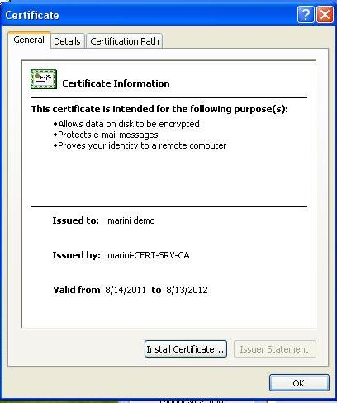
Certificates
Signing certificate
Allows data on disk to be encrypted
Protects e-mail messages

Slide 19
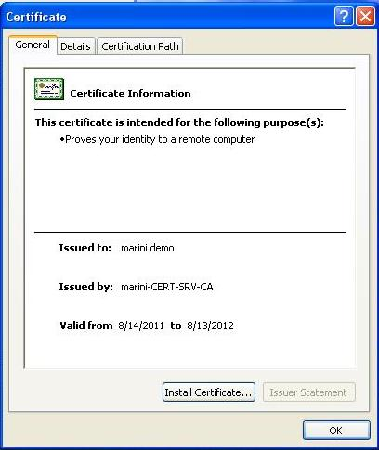
Certificates
Login certificate
Prove your identity to a remote computer

Slide 20
Conclusions
PKI system – secure E-government
Secure:
Transactions
Mail
Ensures data :
Authenticity
Integrity
Confidentiality
Smart card – practical ( like credit cards)

Slide 21
Questions and Suggestions?
Thank You for Your Attention!

