Slide 1
Practical Approach to Teaching Software Testing
Sashko Ristov

Slide 2
Objective
To present several applications developed to be used on laboratory exercises for software testing
For Software quality and testing course

Slide 3
Agenda
About the course
Difficulties and improvements
Input Space Partitioning
Logic Coverage
Conclusions and Future Work

Slide 4
About the course
Weekly (2 + 1 + 2) lessons
2 x theory
1 x theoretical exercises
2 x practical laboratory exercises
Laboratory groups up to 20 students
10 laboratory exercises
Mandatory Project - Practical

Slide 5
Course Objective
To introduce the students with the necessity of software testing,
Why testing is important?
Various software testing techniques,
How to test?
Practical testing, validation and verification of software
What ?

Slide 6
Course Literature
Paul Ammann and Jeff Offutt, Introduction to software testing, Cambridge university press
Ilene Burnstein, Practical Software Testing, Springer professional computing

Slide 7
Agenda
About the course
Difficulties and improvements
Input Space Partitioning
Logic Coverage
Conclusion and Future Work

Slide 8
Course difficulties
Too many similar definitions
Short time to explain and teach all
(Almost all) laboratory exercises are on paper
RESULT:
Students avoid laboratory exercises

Slide 9
Course improvements
This year practical projects from material
develop the application in groups for each laboratory exercise
Students will learn the material
Practical exercise the teaching material

Slide 10
Course improvements
Fully new developed applications for:
Graph Coverage *
Input Space Partitioning
Logic Coverage
Syntax Based Testing *
* - not finished completely yet

Slide 11
Agenda
About the course
Difficulties and improvements
Input Space Partitioning
Logic Coverage
Conclusion and Future Work

Slide 12
Input Space Partitioning
Introduction:
All testing is about choosing elements from the input space of the software being tested
Defining ways to divide the input space according to the test requirements
Domain - Possible values that the input parameters can have

Slide 13
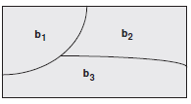
Input Space Partitioning
Each partition must satisfy two properties:
The partition must cover the entire domain (completeness) – All possible cases
The blocks must not overlap (disjoint) - Without duplicates

Slide 14
Input Space Partitioning
COMBINATION STRATEGIES CRITERIA:
All Combinations Coverage (ACoC):
All combinations of blocks from all characteristics must be used.
Each Choice Coverage (ECC):
One value from each block for each characteristic must be used in at least one test case.

Slide 15
Input Space Partitioning
Pair-Wise Coverage (PWC):
A value from each block for each characteristic must be combined with a value from every block for each other characteristic.
Base Choice Coverage (BCC):
A base choice block is chosen for each characteristic, and a base test is formed by using the base choice for each characteristic. Subsequent tests are chosen by holding all but one base choice constant and using each non-base choice in each other characteristic.

Slide 16
Input Space Partitioning
Application Input
Number of variables
Number (and name) of blocks for each variable
Application Output
Minimal test set required for
ACoC, ECC, PWC and BCC

Slide 17
Input Space Partitioning
Example Input
Variable 1
Blocks A (True), B (False)
Variable 2
Blocks 1, 2, 3 (positive, ZERO, negative numbers)
Variable 3
Blocks x (>10), y (<= 10)

Slide 18
Input Space Partitioning
BCC
a 1 x – BASIC Test
b 1 x
a 2 x
a 3 x
a 1 y

Slide 19
Agenda
About the course
Difficulties and improvements
Input Space Partitioning
Logic Coverage
Conclusion and Future Work

Slide 20
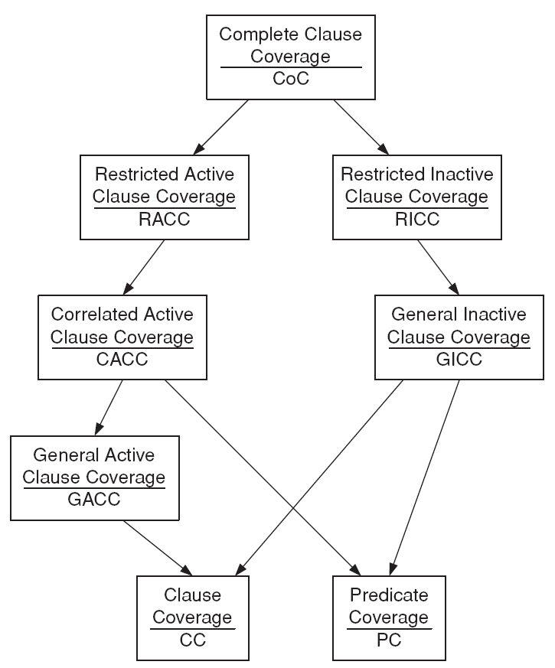
Logic Coverage
Test criteria based on logical expressions
Clauses and predicates are used to introduce a variety of coverage criteria

Slide 21
Logic Coverage
Input variables: Truth Table example
a b c P Pa Pb Pc
1 T T T T T T T
2 T T F F T F T
3 T F T F T T F
4 T F F F T F F
5 F T T F T T T
6 F T F T T F T
7 F F T T T T F
8 F F F T T F F
a, b, c are clauses, p is predicate.
Pa, Pb, Pc are conditions under which the values of a, b, c determine that of p

Slide 22
Logic Coverage
Output variables:
Active Clause Coverage
GACC, CACC, RACC
Inactive Clause Coverage
GICC, RICC
Implicant Coverage (p, p’)
Unique True Point Coverage

Slide 23
Logic Coverage
Output Example:
Variable1: GICC pairs for P=T are: NA
GICC pairs for P=F are: NA
Variable1: RICC pairs for P=T are: NA
RICC pairs for P=F are: NA
Variable1: CACC pairs are: (6,2)(7,3)(8,4)(5,1)
Variable1: RACC pairs are: (6,2)(7,3)(8,4)(5,1)
Variable2: GICC pairs for P=T are: (8,6)
GICC pairs for P=F are: (4,2)
Variable2: RICC pairs for P=T are: (8,6)
RICC pairs for P=F are: (4,2)
Variable2: CACC pairs are: (7,5)(3,1)
Variable2: RACC pairs are: (7,5)(3,1)
Variable3: GICC pairs for P=T are: (8,7)
GICC pairs for P=F are: (4,3)
Variable3: RICC pairs for P=T are: (8,7)
RICC pairs for P=F are: (4,3)
Variable3: CACC pairs are: (6,5)(2,1)
Variable3: RACC pairs are: (6,5)(2,1)

Slide 24
Agenda
About the course
Difficulties and improvements
Input Space Partitioning
Logic Coverage
Conclusion and Future Work

Slide 25
Conclusions
Students can study the material at home, as well
Students can check if their results are (in)correct
We made the course more practical
More effective and efficient studying and teaching

Slide 26
Future Work
Develop more applications for other testing purpose
Upgrade existing applications
Integrate many other already created (open source) testing tools in laboratory exercises
Develop a software package for Teaching Software Testing

Slide 27
Thank you for your attention
Any question?

