Slide 1
Functional Programming Languages
Evis Trandafili
Polytechnic University of Tirana
Albania

Slide 2
Contents
Functional programming language in the hierarchy of programming languages.
There is a language for every task
What is a functional language?
Advantages and disadvantages.
How to implement in the Real World. Why F#?
Implementing F# in an application.

Slide 3
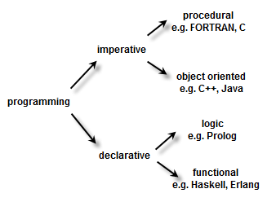
Functional Programming languages
Fields of applications of functional programming
Inside the programming languages hierarchy
DirectX,
Financial Engineering,
AI, Math’s,
Cryptology
Biological Sciences,
Engineering Operations
Management

Slide 4
There’s a language for every task
It's possible to program in an object-oriented style in C, or a functional style in a scripting language. In truth, most modern languages incorporate features and ideas from multiple domains, which only serves to increase the richness and usefulness of these languages. Nevertheless, most languages do not excel at all styles of programming.

Slide 5
There’s a language for every task
Functional languages
Excel at mathematically-oriented programming, and, given the right libraries and visualization tools, a range of scientific and engineering tasks as well.
Extremely powerful when used to implement sophisticated symbolic analyses such as
Hardware verification,
Software verification,
Optimization,
Machine learning
Compilation.

Slide 6
What is a Functional Language?
One that relies on equations.
Ex. When you use a functional language, X = Y means that X and Y are equal. You aren’t assigning the value of Y to X.
There isn’t any state to consider or mutable data to manage.
Functional programs typically make little use of stored state, often abstaining loops in favor of recursive functions. The primary focus of functional programming is on the return values of functions, and side effects and other means storing state are strongly discouraged.

Slide 7
Advantages
In a pure functional language, if a function is called, it is expected that the function not modify any global variables or perform any output. It may, however, make recursive calls and change the parameters of those calls.
Functional languages are often simpler syntactically and make it easier to work on abstract problems, but they can also be "further from the machine" in that their programming model makes it hard to understand exactly how the code is translated into machine language (which can be problematic for system programming).
Functional code, particularly used in the areas where you have to eliminate concurrency.
Type inferencing, type information can stay out of the programmer’s way, less explicit code needed to make the compiler happy, which in turn means that you can express the same concepts in less code.

Slide 8
Disadvantages
The major disadvantage of functional programming is the difficulty of doing input-output since this is inherently non functional. There are also other aspects of problem solving that cannot easily or sensibly be performed in a functional manner.
Nevertheless large programs can be developed with about 80% of the code being designed purely functionally.

Slide 9
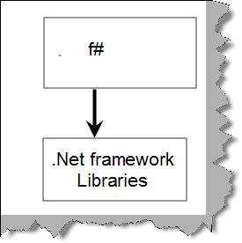
Functional programming in the Real World
F# is an effort to make functional languages useful in the real world (not only academic use). Not only can you mix and match F# with C# or VB.NET (part of Visual Studio 2010), but you can use it to create scripts and perform other complex tasks on its own.

Slide 10
What sort of language is F#?
F# is not simply a functional language: it is a multi-paradigm language that attempts to capture the best of both functional and object-oriented programming.
Even when used as a purely functional language F# is remarkable for the sheer power of the libraries and tools available.
You create the application using equations and then supply data to those equations. An equation can be a constant, a function, an object, or anything else that F# supports.
Strengths of F#:
List processing
Pattern matching (regular expressions)
Concurrent programming strategies

Slide 11
Important Considerations
The final use. Perhaps the most important .
Within a few years, almost every computer will have about 16 cores, so there is a huge need for programming paradigms or idioms that help developers write concurrent software easily
Today applications can’t make use of the additional processors because they aren’t written to exploit them.
Many applications use just a single core and the remaining cores tend to remain idle or at least underused.
F# tends to enforce the requirements for concurrency and make writing these applications considerably easier.
You get these benefits without extra work on your part because they are part of the F# language.

Slide 12
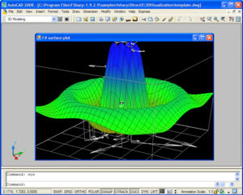
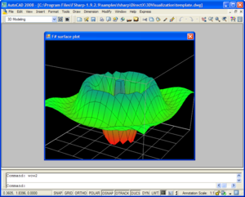
Functional programming applications
The image shows F# running a program using DirectX from .NET

Slide 13
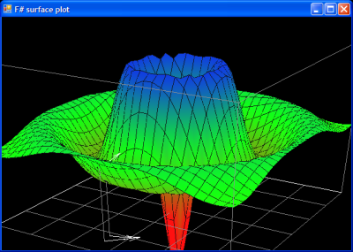
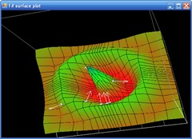
F# is very well suited to simulation and scientific computing
Uses F# to represent
- extremely succinctly code
- a simulated, animated surface.
The application creates a surface representing a function over X & Y coordinates as well as being a function of time.

Slide 14
Biological statistics
Studying the population genes is expensive and impossible if we want information about past genetic population map.
Surnames carry inheritance in male line.
Using surnames in spite of AND information.
What to measure? Indices… izonimy (how homogene is the population in some specific area), Lasker indice (probability that 2 random genes from 2 populations are the same), etc…

Slide 15
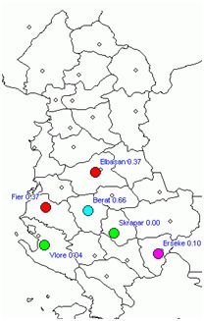
How to implement this using F#?
Analyze the demographic migration in Albanian territory during the last century.
The population integrity of a given area during a given period.
Based on the existing digital system for population registration.
I_{ii} = Σ_{k} (p_{ik})² – 1/N_{i}
Mean population indicator of izonomy.

Slide 16
THANK YOU

