Slide 1
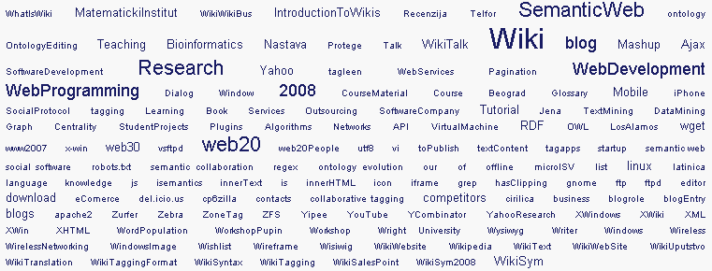
Participative Web: Learning, Semantics, Wiki, Social Tagging, Information Systems, Teaching
Faculty of Electronic Engineering
Department of Computer Science
Intelligent Information Systems Lab
Milorad Tošić
Univeristy of Niš
Faculty of Electronic Engineering Niš, Serbia

Slide 2
Overview
Leathers of Learning and Teaching
Learning: a new reality
Leathers of Learning and Teaching : Now what?
Our approach
Wiki and Social Tagging
Applications
Our experience
Questions

Slide 3
Leathers of Learning and Teaching

Slide 4
Learning: a new reality
Very short “half time” of new knowledge
Acquiring new knowledge and skills must be: frequent, quick, and intensive
Exponential increase in complexity of problems that are worth to address
Only solutions to new and hard problems have value generating potential – repeating known solutions generates almost 0 value
Team work – necessary precondition
Shorter time available for the problem solving
Extremely short and intensive R&D cycle

Slide 5
Learning: New technologies
Adoption cycle of new technologies
Grassroots Video & Collaboration Webs
Collective Intelligence & Social Operating Systems
Four to Five Years
Two to Three Years
Mobile Broadband & Data Mashups
One Year or Less

Slide 6
Learning: Globalization
Digital objects on Internet
Cost of distribution = 0
Time required for distribution = 0
Market size = limitless
Global markets
Global competition
Global (virtual) development teams

Slide 7
Learning: New IT
IT as an infrastructure – traditional
IT as an approach to problem solving - NEW
New IT “for all”: Participative Web
New programming languages
New software development paradigms
Web as a platform

Slide 8
Learning: New “Digital Generation”
Sometimes called “Google Generation”
Multitasking
“Competing simultaneous tasks often provide superficial view, rather than an in-depth understanding, of information”
Learner is capable for extensive focus just in very short period of time
“There is no perceived need to learn or memorize information for latter use since they can always repeat the search experience when needed.”
Julita Vassileva, “Towards Social Learning Environments”, IEEE Trans. On Learning Tech., Oct.-Dec. 2008.

Slide 9
Leathers of Learning : What now?

Slide 10
Our approach: Learning theory background
Active learning
Constructive learning
Participative learning
Reflective practice
Sociocultural theory
“... higher order functions develop out of social interaction” Vygotsky (1986)

Slide 11
Our approach: Philosophy background
Extended mind theory
“the human organism is linked with an external entity in a two-way interaction, creating a coupled system that can be seen as a cognitive system in its own right”
Socially extended mind
Globally extended mind
Internet extended mind
Andy Clark & David J. Chalmers, “The Extended Mind”, Published in Analysis 58:10-23, 1998. Reprinted in (P. Grim, ed) The Philosopher's Annual, vol XXI, 1998.

Slide 12
Our approach: Learning goals
Competitive knowledge
Professional networking
Skills
Long term vs. short term goals

Slide 13
Our approach: Methodologies
Reflective practice
Agile methodologies
Emergent knowledge structures
Collaborative learning

Slide 14
Our approach: Wiki
Wiki Wiki Shuttle
From Wikipedia, the free encyclopedia
The Wiki Wiki Shuttle is a bus system at Honolulu International Airport.
On Havanian language "wiki" stands for quick, while "wiki wiki“ means very quick.

Slide 15
What is aWiki?
Wiki: Software, knowledge, community
A wiki Web site is a set of Web resources that can be easily and quickly created and/or edited via a Web-based interface by anyone who is allowed access.
One or more people are collaborating on building up a corpus of shared knowledge in a collection of interlinked Web pages.
A wiki Web site is accompanied with a social protocol supporting the community of users
Bowen, J., Wiki Software and Facilities for Museums, in J. Trant and D. Bearman (eds.). Museums and the Web 2008: Proceedings, Toronto: Archives & Museum Informatics. Published March 31, 2008. Consulted June 14, 2008. http://www.archimuse.com/mw2008/papers/bowen/bowen.html

Slide 16
Wiki as a paradigm change:
Work in the presence of uncertainty:
Produce results that will be valuable in the future!
In the presence of the constant change globally, we are not able to predict future!
Reflective Practice:
“The thing that make us smart” (what people and computers can do together?) [Fisher, 2001]

Slide 17
Wiki aspects
Social and Community
Emergence and Networks
Technology
Semantics and Knowledge
End-User Programming

Slide 18
Social and Community aspect: Individual vs. collective intelligence
Wiki is a new social interaction medium for publishing new form of intellectual artifacts: so called Live Documents.

Slide 19
Features: User interface
Content generation
Action-Specific forms
Text editors
Plain-Text editors (Wiki markup)
Reach-Text editors (WYSIWYG – “vizivig”)
Attachments
Documents, Images, Multimedia

Slide 20
Features: User registration
Content generation: Action-Specific forms
User management

Slide 21
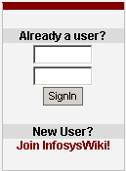
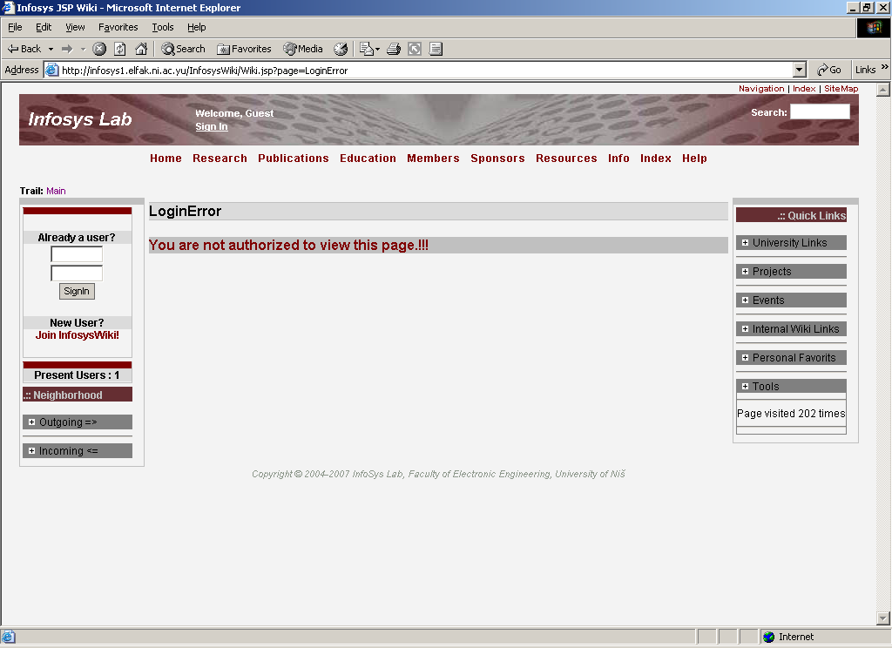
Features: Access rights and groups
Not in Work Group?
You don’t have privileges to
VIEW and EDIT
this page content
Permissions for users and working groups:
VIEW page content
EDIT page content
PRINT page content
CREATE new page
ATTACHMENTS per page

Slide 22
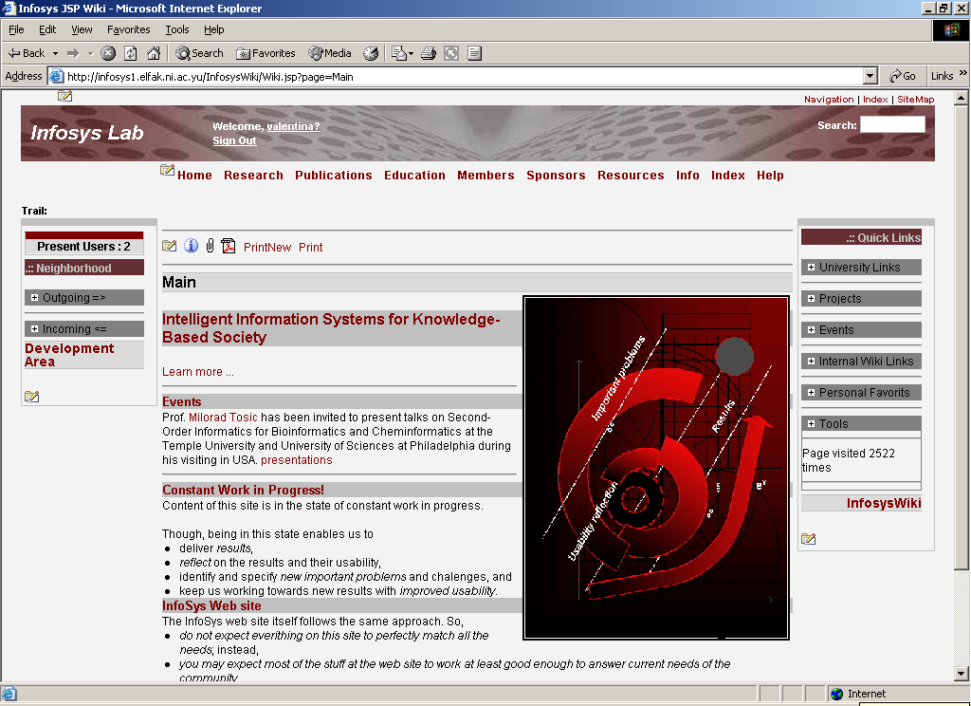
Menu creating and editing
Page attachments as documents and pictures
Page and content creating and editing
Different ways of the content printing

Slide 23
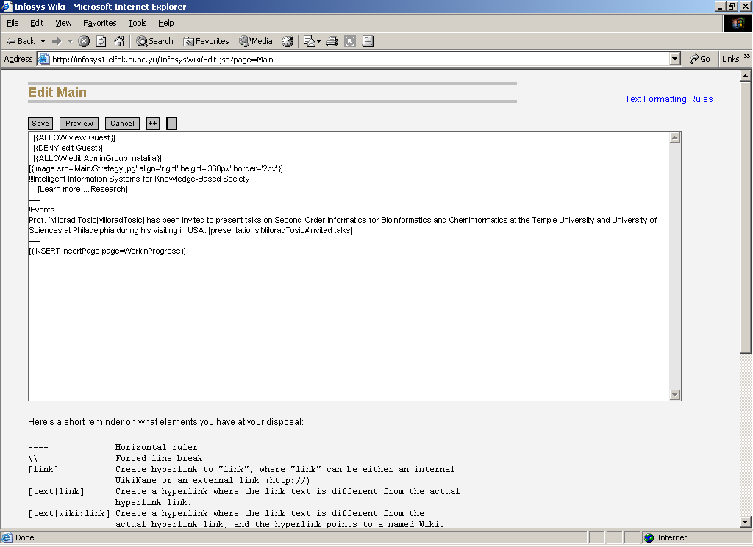
Features: Plain-text editor

Slide 24
Features: Reach-Text editor (WYSIWYG – “vizivig”)
The WYSIWYG editor provides familiar tools for adding formatting, images, links, and multimedia elements to a Wiki page.
http://www.unf.edu/dept/cirt/bb/teamslx.html
http://developer.yahoo.com/yui/editor/

Slide 25
Problem: Semantics
Meaning, context and social value

Slide 26
Social Tagging: Wiki approach

Slide 27
Social Tagging: Personal profile Wiki page

Slide 28
Social Tagging : Semantic concepts

Slide 29
Social Tagging: Communication
Personal tags of a single user
Tag cloud of communication between two users
Shared tag cloud

Slide 30
Social Tagging: “File” concept as a wiki page
Tagging: Semantic links between concepts
Visual representation of the concept
End-user’s comments

Slide 31
Applications: Wiki Mashups
The Bioinformatics demo

Slide 32
Our experience: 4 years
Year | # Registered users | # pages | # reads | # edits
2005 | 0 | 0 | 3645 | 613
2006 | 67 | 99 | 27352 | 2287
2007 | 201 | 728 | 70911 | 8477
2008 | 212 | 1137 | 104094 | 6473
2009 | 574 | 2214

Slide 33
Our experience: 8 courses, > 2000 students

Slide 34
Our experience: Course “Semantic Web”
Ontology based automatic Multiple Choice Questions Test Generator
Agile methodology for software development
Group of 12 students
InfosysWiki intensively used during the course
Every student gave 15-minutes talk in front of other students
All materials, documents, code, news available immediately at InfosysWiki

Slide 35
SeMCQ wiki page http://infosys3.elfak.ni.ac.yu/nastava/Wiki.jsp?page=SemantickiWebKurs
YouTube Video “in plain English” intro developed by students
Image show from the Protégé Conference
Simple download and install instructions
Embedded SeMCQ–specific tag cloud from www.tagleen.com
Wiki discussion & comments

Slide 37
Participative Web: Learning, Semantics, Wiki, Social Tagging, Information Systems, Teaching
Faculty of Electronic Engineering
Department of Computer Science
Intelligent Information Systems Lab
Thanks for your attention!
QUESTIONS?
mbtosic@yahoo.com http://infosys1.elfak.ni.ac.yu

