Slide 1
Adaptive and Collaborative eLearning Architectures
S.Stoyanov
University of Plovdiv

Slide 2
Content
Introduction
eLearning Infrastructure and Adaptation
Development Approach
Projects
Implementation Remarks
Conclusion

Slide 3
Introduction
2001 E-Commerce laboratory
  Masters Program in SE
  E-Commerce Software Architectures
  Prototype implementations
In the last years
  Change of the domain
  eLearning

Slide 4
Introduction
Different definitions, approaches, models, … for IT supported education and learning
  CBT: predetermined learning by
    Time
    Place
    Content
  eLearning
    Personalization
    Anywhere
    Anytime
Notes:
In the specialized issues there are different definitions, approaches, models, ... for IT-based education
The most of the currently used systems can be added to the group of CBT.
Unlike the CBT, the eLearning presumes (by definition) much more. The most important features of a eLearning-oriented system are:
Personalization;
Anywhere and any time access to the learning material.
Providing of an anywhere and anytime personalized access to the learning resources is the most crucial property of an eLearning-based system.
With the eLSE project we try to develop an eLearning-oriented infrastructure which can be used for distance education in the field of Software Envineering.
What we need to guarantee the success of the work? We consider four basic aspects.

Slide 5
Education Forms
Just-in-Time
?
eLearning
Self-paced CBT
Generalized
Personalized
Content-axe
Distance CBT
Context-axe
Academic Education
Just-in-Case

Slide 6
What do we need?
In order to ensure
  Personalization
  Anywhere
  Anytime
What kind of
  Development
  Software architecture
  Access
  eContent structuring

Slide 7
Research Goals
Theoretical and Conceptual Framework for eLearning Supporting Infrastructure
Prototype Implementation
Experiments
  Real education environments

Slide 8
Conceptual Model
Domain
Model
User
Model
Pedagogical
Model
Generate
eContent
Interprate

Slide 9
Distributed Architectural Model
eLN
eLN
eLN
eLN
eLN

Slide 10
First Adaptation Level:
Mapping to a Communication Environment
eLN
eLN
eLN
eLN
eLN
?
InfoStation-Based Network

Slide 11
Second Adaptation Level:
Separate and Cluster Mode
eLN
eLN
eLN
Cluster
eLN
eLN
Notes:
Cluster building is only dynamic - there are different cases which cause the cluster building – for example:
Movement of the user – IS changing;
Resource deficit – globalization of the requests

Slide 12
Third Adaptation Level:
Fixed, Mobile, Mixed Access
eLN
eLN
eLN
Cluster
eLN
eLN

Slide 13
Fourth Adaptation Level:
Personalization by Models
Pedagogical
Model
eLN
eLN
eLN
Cluster
?
Domain
Model
eLN
eLN
User
Model
Notes:
User personal computing space which can include:
Schedules, personal calendars, address books, contact lists, to-do lists;
More dynamic information has to be sensed in real time from the user’s environment:
Position, orientation, identities of people nearby, locally observable objects and actions, emotional and physiological state

Slide 14
Adaptation Process: Levels
Infrastructure
Mode
Access
Model
Fixed
Mobile
Mixed
User
Domain
Pedagogical
InfoStation network
Stand-alone
Cluster

Slide 15
Development Challenges
PI Level
eLS₁
eLS₂
…
eLS_{n}
n
n
mapping
mapping
Middleware level
1
PS Level
Notes:
In our case we have to convert the PIM to a specific platform – InfoStation architecture.
We haven’t standard mappings and appropriated tools and have to realize the mapping by hand.
PIM – specification and modeling of eLearning functionality.
Our idea is the following: based on the platform, we try to raise the level of platform abstraction towards PIM.
In this case, we hope to have the needed mapping more simple.

Slide 16
Basic Approach
eLearning Service Level
Management
FAM
Middleware Level
Management
SAM
Scenario Level
Management
Notes:
In our approach we are going to modify the proposed by the MDA way and our work spread out to the following tree levels:
Functional level – at this level we are creating an eLearning services model;
Scenarios level – scenarios are representative for access and communication environment which the services will be executed in.
The different scenarios describe the characteristics and the possibilities of the underlain communication infrastructure (InfoStations);
Agent & services level - at this level a set of appropriate agents and services, which can support the scenarios execution, is defined.
In respect to the eLearning services this level provides the needed run-time, i.e. a virtual machine.
The creation of this level is a big challenge for us.
In addition we need two mappings:
Function-to-Agent-Mapping – for each of eLearning services we define a set of agent/services which can support theirs execution;
Scenarios-to-Agent-Mapping – for each scenario we define a set of corresponding agents/services.
To each level we try to find suitable control models.

Slide 17
Scenario Level
Idea:
  Presentation of access and communication infrastructure as a set of run-time scenarios
  Details hiding
  Implementation on an more abstract level
Four basic scenarios
  No change
  Change of InfoStation
  Change of Device
  Change of InfoStation and Device

Slide 18
Extended Approach
eLearning Service Level
Management
Iterations:
Scenario-Middleware
eLearningService-Middleware
FAM
Middleware Level
Management
SAM
Scenario Level
Management

Slide 19
Scenario-Middleware Iterations
Basic Architecture
  Reactive and Proactive Software Components
  Agent- and Service-Oriented
Time-Based Management
  ITL-Based Model
Resource Deficit
  Globalization of Services
Adaptation
  User- and Domain-Model
  Pedagogical-Goal-Driven Education
Collaboration
  Semantic-Oriented Communication
  Distributed Scenario Identification
Optimization
  Different Optimization Solutions possible

Slide 20
The next iteration: TBM
Distributed scenario identification
In different IS local event
By collaboration between the agents is possible to identify the current scenario
Time is important for the scenario identification
Formalization
  ITL

Slide 21
eLService-Middleware Iterations
Mapping Service Functionality to the Middleware
  ELF Specification
  First Iteration
    eTest
Enrichment the middleware with new agents

Slide 22
User Model
How to present the user’s characteristics?
User Device
  CC/PP Standard
    Composite Capabilities
    Preference Profiles
    RDF Presentation
Knowledge Background

Slide 23
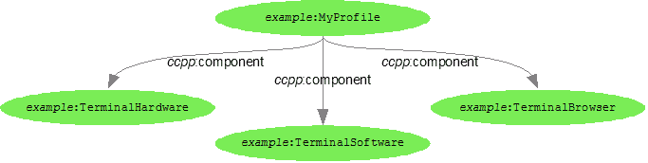
User Profile
CC/PP profile tree:
the hardware platform upon which software is executing,
the software platform upon which all applications are hosted, or
an individual application, such as a browser.

Slide 24
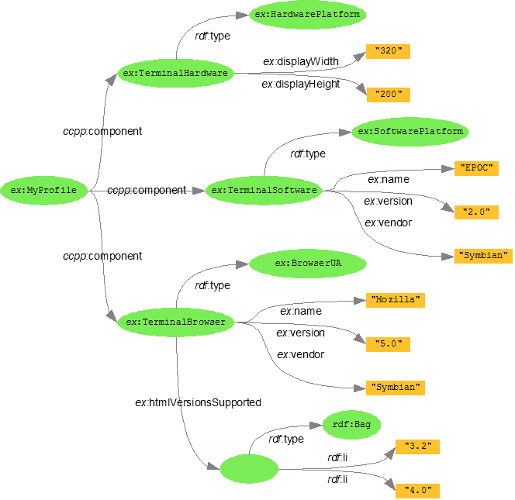
User Profile Example

Slide 25
Domain Model
How to present the eLearning content?
LOs Networks
  Relations between the different LOs
Domain-Depended Ontologies
Digital Libraries
Multilayered Architecture

Slide 26
Pedagogical Model
How to ensure a goal-driven management of the eLearning process?
Session management
  Initialization
  Generation of a personalized pedagogical goal
  Decomposition into subgoals
  Goal- and Time-Driven Management
  BDI agent architecture
  ITL
  Closing
Presentation of the model

Slide 27
Projects
Software Engineering DIgital Library (SEDiLia)
  Fixed access to the eLearning services and eContent
Context-Aware Mobile E-Learning System (CAMELS)
  Mobile access to the eLearning services and eContent

Slide 28
SEDiLia
Development of a digital library “Software Engineering”
Development of two applications using the DiLi
  Development Environment
  Education Portal
Research in development of flexible, adaptive, collaborative and Semantic Web-oriented software architectures

Slide 29

SEDILIa Architecture
StudentWorkplace
Digital Library
Lecturer Workplace
Notes:
The kernel of the architecture is the digital library which has to be implemented independent from the using it applications.
In addition two applications were proposed which will demonstrate the usage of the library.
The first one is a lecturer’s work place helping by preparation of teaching material.
The second one is a education portal by help of which the students have access to the electronic content.

Slide 30
CAMELS
Elaboration of an approach and development of an adaptive software architecture for personalized mobile access to electronic content and services in InfoStation networks
Development of models for context-aware execution of electronic educational services
Development of time-dependent models for management of processes in the middleware system
Prototype implementation of the middleware, realized as agent-oriented environment for mobile and personalized access to educational content and services
Realization of specific educational services, demonstrating the functionality and properties of the environment
Development of a prototype of personal assistant agent, aiding the users working with the environment

Slide 31
CAMELS Middleware Architecture

Slide 32
Implementation
General environment
  J2EE (EE 5)
Agents
  JADE
    Jadex
    WS2JADE
  CybelePro
Portals
  Life Ray
SCORM Run-Time Engine
Ontologies
  Protégé

Slide 33
… and now
Rethinking the hole architecture
From a new point of view
  Pervasive Computing
Is there any relation between our research and ‘Pervasive Computing’ ?
    Two typical scenarios for pervasive computing

Slide 34
Scenario 1
Jane is at Gate 23 in the Pittsburgh airport, waiting for her connecting flight. She has edited many large documents, and would like to use her wireless connection to e-mail them. Unfortunately, bandwidth is miserable because many passengers at Gates 22 and 23 are surfing the web.
Aura observes that at the current bandwidth Jane won’t be able to finish sending her documents before her flight departs. Consulting the airport’s network weather service and flight schedule service, Aura discovers that wireless bandwidth is excellent at Gate 15, and that there are no departing or arriving flights at nearby gates for half an hour. A dialog box pops up on Jane’s screen suggesting that she go to Gate 15, which is only three minutes away. It also asks her to prioritize her e-mail, so that the most critical messages are transmitted first. Jane accepts Aura’s advice and walks to Gate 15. She watches CNN on the TV there until Aura informs her that it is close to being done with her messages, and that she can start walking back. The last message is transmitted during her walk, and she is back at Gate 23 in time for her boarding call.
Change InfoSattion Scenario ?

Slide 35
Scenario 2
Fred is in his office, frantically preparing for a meeting at which he will give a presentation and a software demonstration. The meeting room is a ten-minute walk across campus. It is time to leave, but Fred is not quite ready. He grabs his PalmXXII wireless handheld computer and walks out of the door. Aura transfers the state of his work from his desktop to his handheld, and allows him to make his final edits using voice commands during his walk.
Aura infers where Fred is going from his calendar and the campus location tracking service. It downloads the presentation and the demonstration software to the projection computer, and warms up the projector. Fred finishes his edits just before he enters the meeting room. As he walks in, Aura transfers his final changes to the projection computer. As the presentation proceeds, Fred is about to display a slide with highly sensitive budget information. Aura senses that this might be a mistake: the room’s face detection and recognition capability indicates that there are some unfamiliar faces present. It therefore warns Fred. Realizing that Aura is right, Fred skips the slide. He moves on to other topics and ends on a high note, leaving the audience impressed by his polished presentation.
Change Device Scenario ?

Slide 36
Proactivity
Scenario 1
  Shows the importance of proactivity
Scenario 2
  Illustrates the ability to move execution state effortlessly across diverse platforms
  Embodies many instances of proactivity

Slide 37
… and Conclusion
Surprise in these scenarios - how simple all component technologies are
  Hardware
    Laptops, handhelds, wireless communication, room cameras, …
  Component technologies
    Location tracking, face recognition, speech recognition, online calendars, …
Why then do these scenarios seem like science fiction rather than reality today?
  The whole is much greater than the sum of its parts
  The real research is in the seamless integration of component technologies
  The difficult problems lie in architecture, component synthesis and system-level engineering

Slide 38
Pervasive Computing (PC)
The research agenda of PC subsumes that of Mobile Computing
PC incorporates four additional research thrusts:
  Effective Use of Smart Spaces
  Invisibility
  Localized Scalability
  Masking Uneven Conditioning

Slide 39
User’s Personal Computing Space
UPCS can include:
  Schedules, personal calendars, address books, contact lists, to-do lists;
  More dynamic information has to be sensed in real time from the user’s environment:
    Position, orientation, identities of people nearby, locally observable objects and actions
    Emotional state
    Physiological state

Slide 40
Impact of Layering
Layering cleanly separates abstraction from implementation
  In thus consistent with sound software engineering
Merging of information from diverse layers
  To produce an effective response
Example for combining knowledge from different layers:
  Wireless congestion is a low-level system problem
  Knowledge of boarding time is an application or user-level concept
  Only by combining these disparate pieces of knowledge can the system propose a solution
Reactive and proactive layers

Slide 41
Thank you!

