Slide 1
Using Flowchart-based Programming Environments for Simplifying Programming and Software Engineering Processes
13th Workshop "Software Engineering Education and Reverse Engineering"
Stelios Xinogalos
Department of Applied Informatics
School of Information Sciences
University of Macedonia
Thessaloniki, Greece
stelios@uom.gr

Slide 2
INTRODUCTION
Visual formalisms have attracted great interest and have been heavily used in Computer Science and related fields.
A characteristic example is Harel’s statecharts that resulted from an effort to define diagrams that describe the behavior of reactive systems.
Statecharts were initially devised for avionics, but are now used in telecommunications, hardware design, control systems and other areas, while a variant of them has become part of UML.

Slide 3
INTRODUCTION
Flowcharts are a type of charts that have been heavily utilized in the past as a means of introducing novices to algorithms and programming.
Flowcharts can be very effective for visual learners both for writing and comprehending algorithms.
After several years of utilizing flowcharts as a means of learning algorithms and programming, they were gradually abandoned due to:
the fact that designing and especially modifying flowcharts using paper and pencil is an impractical, time-consuming and tedious process for novices
flowcharts in paper format are static and do not provide any help for comprehending neither the dynamic nature of program execution nor the control structures

Slide 4
CONTENTS
Comparative analysis flowchart-based environments.
Emphasis is given on fundamental technologies and advanced features of contemporary environments.
Experiences on using RAPTOR for preparing educational material for an introductory programming course.
Conclusions are drawn regarding possibilities for research on the field and for utilization of such environments for a brief and simplified introduction to other fundamental fields, concepts and models of software engineering (in addition to programming).

Slide 5
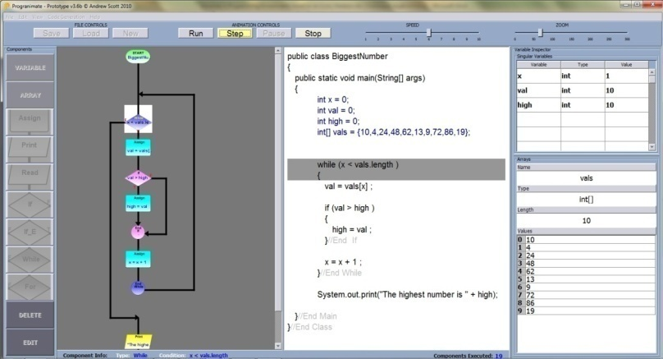
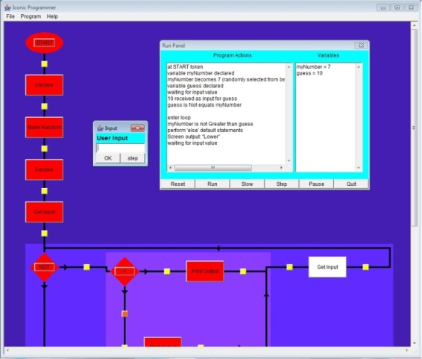
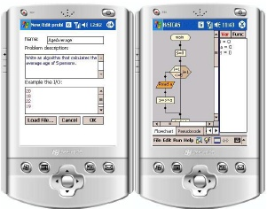
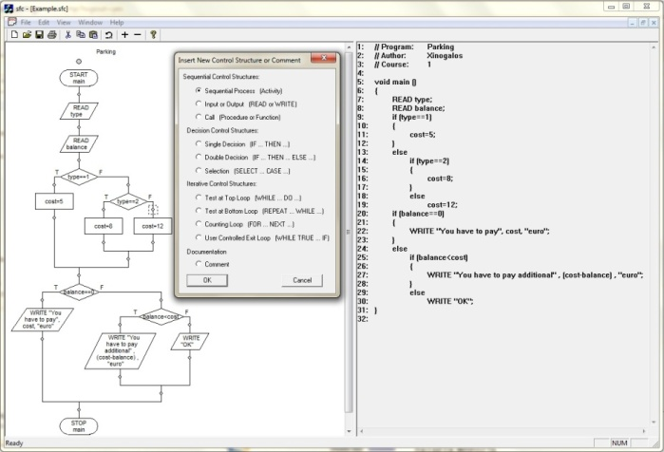
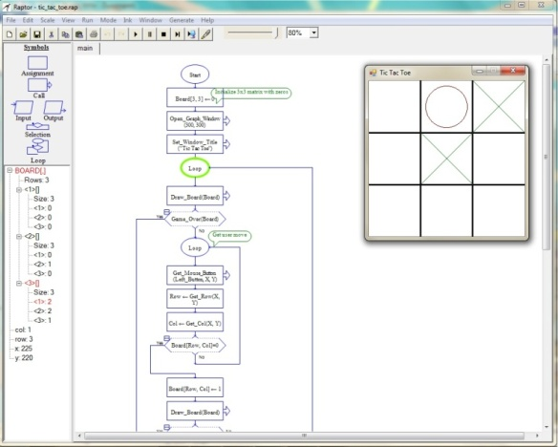
PART I: COMPARATIVE ANALYSIS OF FLOWCHART-BASED PROGRAMMING ENVIRONMENTS

Slide 6
FUNDAMENTAL TECHNOLOGIES
Syntax-directed editing
Structure editors
Iconic programming languages √
Software visualization
Program animation

Slide 7
COMPARATIVE ANALYSIS
Flowchart-based programming environments that were developed for academic and not commercial purposes are reviewed.
For each environment important data are presented regarding:
availability
program development
program execution
automatic source code generation
evaluation

Slide 8
COMPARATIVE ANALYSIS - availability
Several programming environments based on an iconic, flowchart-based notation have been developed, starting back from 1994 with BACCII.
Four out of the eleven most referenced environments reviewed are available.
This kind of programming environments has attracted so much interest that even nowadays the development of new environments is announced.
Environment | Available
BACCII/ BACII++
FLINT
SFC Editor | √
RAPTOR | √
SICAS
SICAS-COL
H-SICAS
ProGuide
B#
Iconic Programmer | √
Progranimate | √

Slide 9
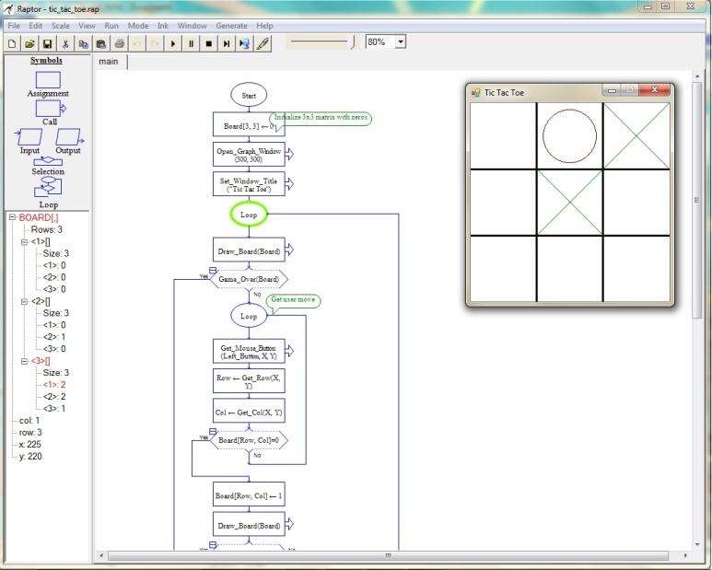
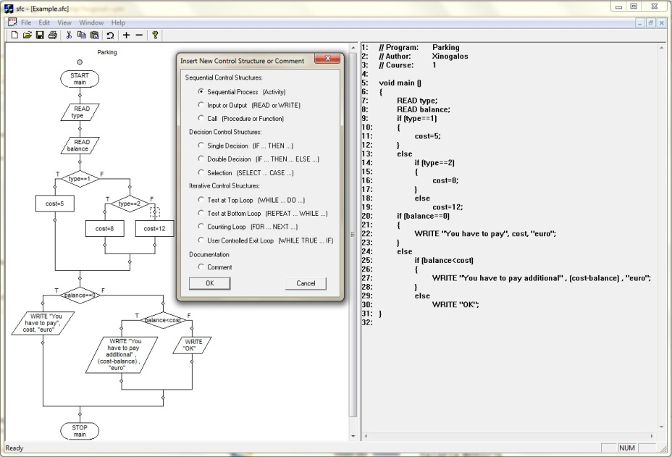
COMPARATIVE ANALYSIS - availability
Iconic Programmer
Progranimate
RAPTOR
SFC Editor

Slide 10
COMPARATIVE ANALYSIS - notation
Programs are developed with the form of a flowchart.
In some cases, symbols have the same shape and a characteristic icon: iconic programming languages.
Iconic programming languages, usually, have an extended instruction set.
Some environments use a hybrid approach. For example, in Iconic Programmer same shaped icons are used with a label showing the type of the statement.
In RAPTOR, UML class diagrams are also supported when the user selects the object-oriented mode.
Environment | common symbols | same shaped icons
BACCII/ BACII++ |  | √
FLINT | √
SFC Editor | √
RAPTOR | √
SICAS | √
SICAS-COL | √
H-SICAS | √
ProGuide | √
B# |  | √
Iconic Programmer |  | using text
Progranimate | √

Slide 11
COMPARATIVE ANALYSIS – programming paradigm
Environment | Imperative procedural | Object Oriented
BACCII/ BACII++ | √ | √
FLINT | √
SFC Editor | √
RAPTOR | √ | √
SICAS | √
SICAS-COL | √
H-SICAS | √
ProGuide | √
B# | √
Iconic Programmer | √
Progranimate | √
The vast majority of flowchart-based programming environments support the imperative-procedural programming.
BACCII++ and RAPTOR support both procedural and object-oriented programming.
RAPTOR:
UML class diagrams
Inheritance, polymorphism, class nesting, association, composition, aggregation and dependency can be depicted
structured flowcharts are used for implementing the body of each method declared in a class

Slide 12
COMPARATIVE ANALYSIS - execution
Program animation provides great support in:
comprehending the semantics of programming structures
comprehending flow of control
locating and correcting logic errors
Automatic update of variables gives the ability to run the program with different data sets and comprehend both the role and modification of variables depicted in the chart

Slide 13
COMPARATIVE ANALYSIS - execution
Environment | Program animation
BACCII/ BACII++
FLINT | √
SFC Editor
RAPTOR | √
SICAS | √
SICAS-COL | √
H-SICAS | √
ProGuide | √
B# | √
Iconic Programmer | √
Progranimate | √
Flowcharts are executed using program animation with automatic update of variables (exceptions: BACII/BACCII++, SFC)
SICAS: backward step by step execution is possible
B#: users can execute the Borland Pascal source code automatically generated from the flowchart
ProgrAnimate: synchronized step by step execution of both the flowchart and the code automatically generated
Iconic Programmer: explanatory visualization is used for presenting explanatory messages in natural language

Slide 14
COMPARATIVE ANALYSIS – automatic source code generation
Supports novices in comprehending the relation between algorithms described with a flowchart and its implementation in a programming language.
Gives the chance to study and run the program that corresponds to their algorithm, without having to be concentrated from the very beginning to the difficult, time-consuming and sometimes frustrating process of debugging.
The ability of generating source code in various languages presents in a clear manner the fact that a well-designed algorithm can be easily translated to various programming languages.
The most important factor in solving a problem is designing an algorithm and not thinking of it in the context of the programming language that will be used for implementing it.

Slide 15
COMPARATIVE ANALYSIS – automatic source code generation
Environment | Languages
BACCII/ BACII++ | Pascal, C, Fortran, Basic, C++
FLINT
SFC Editor | Pseudo code in C++ or Pascal
RAPTOR | Ada, C#, C++, Java
SICAS | Pseudo code, C, Java
SICAS-COL | ≠
H-SICAS | ≠
ProGuide
B# | Borland Pascal
Iconic Programmer | Pseudo code, Java, Turing, C/C++
Progranimate | Java-like pseudo code, Java, VisualBasic.NET, VisualBasic 6.0, Pascal, JavaScript
Most of the environments offer more than one target language choices, with more common Pascal and Java.
BACCII/BACCII++, RAPTOR, SICAS, B#, Iconic Programmer and Progranimate generate syntactically correct source code, ready to execute
B# supports the execution of the source code within the environment
Progranimate supports the synchronized execution of the flowchart and the source code.
RAPTOR offers the ability of developing a generator of source code for other languages by developing a C# class.

Slide 16
COMPARATIVE ANALYSIS - evaluation
Environment | Evaluation
BACCII/ BACII++ | √
FLINT | √
SFC Editor | √
RAPTOR | √
SICAS | √
SICAS-COL
H-SICAS
ProGuide
B# | √
Iconic Programmer
Progranimate | √
Evaluation results are available for several of the environments reviewed.
However, all these studies were carried out by, or with the participation of, the teams that developed them.
Unfortunately, we could not locate independent studies not even for RAPTOR that according to its developers is used in seventeen countries around the world.
Such evaluation seems to be more easily carried out for Progranimate, since evaluation materials and links both for students and experts are available in the web site of the tool.

Slide 17
COMPARATIVE ANALYSIS – special features
Environment | Special features
FLINT | Imposes the waterfall programming model
RAPTOR | Notation: UML class diagram Source code generation: allows development of source code generators for other languages
SICAS | Execution: stepping backward
SICAS-COL | Supports collaborative activities
H-SICAS | Adaptation of SICAS for usage on mobile devices
ProGuide | Uses a tutoring system model
B# | Both the flowchart and the generated program can be executed
Iconic Programmer | Execution: explanatory visualization
Progranimate | Deployment: can be integrated into a web page Execution: synchronized execution of flowchart & source code

Slide 18
PART II: EXPERIENCE IN PREPARING EDUCATIONAL MATERIAL WITH RAPTOR

Slide 19
MOTIVATION
After teaching for several years an introductory Computer Programming (imperative-procedural, based on C) course at the Technology Management Department at the University of Macedonia it was clear that students face several difficulties.
Taking into account the facts that:
Most of our students have been introduced to the main principles of procedural-imperative programming at the 3rd Grade of the Lyceum, with the use of a pseudo-language and flowcharts.
Students always ask for exemplary solved exercises.
the decision to prepare supplementary material for standalone study by students was taken.

Slide 20
USING MULTIPLE REPRESENTATIONS
The material was decided to contain a set of exemplary solved exercises using multiple representations :
pseudo-code
flowchart
program in C
along with methodology for solving similar problems.
Hypothesis: both visual and non-visual learners, as well as experienced and non-experienced students would be able to select as a starting point the representation that better suits them for comprehending basic programming concepts.
RAPTOR was utilized for designing the “flowchart representation”.

Slide 21
EXPERIENCE WITH RAPTOR
Basic statements: variables, input, output, assignment, expression
Selection structures: if, if..else, if…else if, switch, nesting
Repetition structures: while, for, do…while, nesting
Functions: defining and calling functions, return type, parameters, arguments
Arrays
Pointers: using pointers as parameters
Strings: strings as arrays of characters, functions for manipulating strings

Slide 22
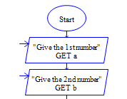
EXPERIENCE WITH RAPTOR – things to be aware of…
Basic statements: variables, input, output, assignment, expression
In RAPTOR there is no explicit variable and data type declaration.
RAPTOR variables:
are implicitly declared on first use (assignment or input statement)
they must be assigned a value on first use and
based on that value it’s data type will be Number, String, or an Array of Numbers
Automatically generated C++ source code:
int main()
{
?? b;
?? a;
…

Slide 23
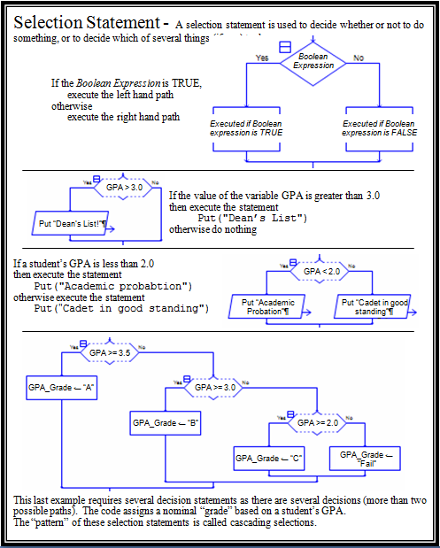
EXPERIENCE WITH RAPTOR – things to be aware of…
Selection structures: if, if..else, if…else if, switch
if (GPA>3)
{
cout << "Dean's list!" << endl; }
else
{
}
1
1
2
2
if (GPA<2)
{
cout << "Academic Probation" << endl; }
else
{
cout << "Cadet in good standing" << endl;
}

Slide 24
EXPERIENCE WITH RAPTOR – things to be aware of…
if (GPA>=3,5)
{
GPA_Grade ="A";
}
else
{
if (GPA>=3)
{
GPA_Grade ="B";
}
else
{
if (GPA>=2)
{
GPA_Grade ="C";
}
else
{
GPA_Grade ="Fail";
}
}
}
3
3
Nested if/else structures are used in the generated source code

Slide 25
EXPERIENCE WITH RAPTOR – things to be aware of…
RAPTOR proposal
There is one kind of loop but with the possibility to check the condition in different places.
The RAPTOR loops stop executing when the condition becomes true!
If you want to exit when the condition is false set the registry entry HKEY_LOCAL_MACHINE\Software\Raptor\reverse_loop_logic to true.

Slide 26
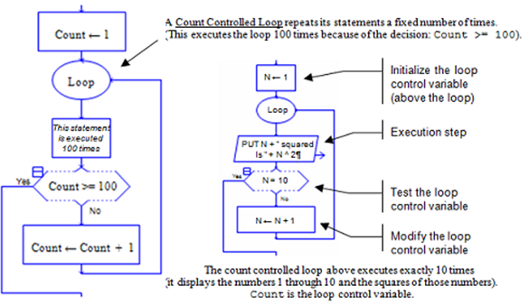
EXPERIENCE WITH RAPTOR – things to be aware of…
int main()
{
?? n;
N =1;
while (1)
{
cout << N+" squared is "+N ** 2 << endl;
if (N==10)) break;
N =N+1;
}
return 0;
}
A for loop can be depicted, but the generated source code is a middle-exit while loop.

Slide 27
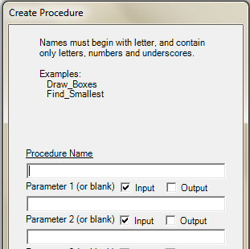
EXPERIENCE WITH RAPTOR – things to be aware of…
Functions: defining and calling functions, return type, parameters, arguments
RAPTOR has built-in functions (math, trigonometric, string), but it supports only user-defined procedures and not functions.
RAPTOR procedures can have:
input parameters
output parameters
input/output parameters

Slide 28
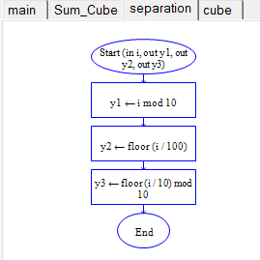
EXPERIENCE WITH RAPTOR – things to be aware of…
Even when the user creates a subprogram that returns just one value (function) in RAPTOR it is created as a procedure with an output parameter:
pointers
Automatically generated C++ source code:
void separation (
?? i;
??_Variable *y1;
??_Variable *y2;
??_Variable *y3)
{
y1 =i % 10;
y2 =floor(i/100);
y3 =floor(i/10) % 10;
}

Slide 29
EXPERIENCE WITH RAPTOR – results…
No formal evaluation of the didactical value of the material has taken place yet.
However based on discussions with students, it seems that:
several students find the material useful for comprehending programming concepts and carrying out their weekly assignments
students with prior experience in pseudo-language/flowcharts are supported in making the connection to the more strict syntax in C – however, it is not clear whether pseudo-language or flowcharts are more heavily utilized
students without prior experience are also supported in comprehending programming concepts and algorithms expressed in the pseudo-language

Slide 30
PART III: CONCLUSIONS & POSSIBILITIES FOR RESEARCH

Slide 31
CONCLUSIONS
(1) Contemporary Flowchart-based environments have advanced features:
Support for object-oriented programming and UML class diagrams [RAPTOR]
Running through the program automatically generated from the flowchart, and not just the flowchart [B#]
Synchronized execution of a flowchart and the corresponding source code [Progranimate]
Explanatory visualization [Iconic Programmer, partially in Progranimate]
Integration into a Learning Management System, or utilizing it for developing an enhanced e-learning system [Progranimate]
Support for collaborative activities [SICAS-COL]
Usage in mobile devices [H-SICAS]
Integrating a tutoring system model [ProGuide]

Slide 32
CONCLUSIONS
(2) A Flowchart-based environment integrating the recorded advanced features would be even more effective:
It would be interesting to devise an environment that integrates the advanced features that appear in different environments in a way that the environment does not lose its simplicity.
Such an environment could support:
procedural and object-oriented programming
step by step execution and data visualization
automatic generation of syntactically correct source code in various modern production programming languages
collaborative activities and distributed pair programming and
ideally run on the web and mobile devices that are currently part of students’ everyday life

Slide 33
CONCLUSIONS
(3) RAPTOR supports effectively the fundamental imperative-procedural programming concepts/constructs
Input, output, assignment, selection, repetition, functions, arrays, functions
User-friendly GUI
Step by step execution with automatic data visualization
Automatic generation of source code, which however needs some interventions
It works fully only on Windows and with some features removed on Ubuntu

Slide 34
CONCLUSIONS
(4) Evaluation of the didactical/pedagogical value of flowchart-based programming environments is required:
The advanced features of programming environments based on an iconic, flowchart-based notation are based on technologies that have generally proven useful in the area of programming.
However, they have not been adequately evaluated in the context of the specific kind of programming environments.
Research on this area is required in order to shed light on the true didactic and pedagogical value of flowchart-based programming environments in introducing novices to programming.

Slide 35
CONCLUSIONS
(5) Investigation of potential usage of such environments for introducing students to SE concepts:
It would be interesting to investigate at what degree such environments could be used for introducing novices to other fields, concepts and models of software engineering in addition to programming.
RAPTOR, which is the most complete environment of this kind, could be used for devising special hands-on activities for familiarizing students with various software engineering topics in a simplified manner:
presenting the importance of software design (in the context of a problem demanding “good” design, i.e a game)
utilization of UML diagrams (designing multiple class solutions)
necessity for software testing (taking into advantage program animation)
synergy of programming paradigms

Slide 36
REFERENCES
Stelios Xinogalos. 2013. Using Flowchart-based Programming Environments for Simplifying Programming and Software Engineering Processes. In Proceedings of 4th IEEE EDUCON Conference, Berlin, Germany, 13-15 March 2013, IEEE Press, 1313-1322.
Presented in the Special Session “Technical Didactic Software Engineering”
Stelios Xinogalos. 2012. Programming Techniques and Environments in a Technology Management Department. In Proceedings of the 5th Balkan Conference in Informatics (BCI 2012), 16-20 September, Novi Sad, Serbia, ACM, New York, NY, USA, 136-141.

Slide 37
Thank you!

