Slide 1
Custom driven scientific information extraction from digital libraries using integrated text mining services
Betim Çiço, Adrian Besimi, Visar Shehu
14th Workshop on Software Engineering Education and Reverse Engineering
24-30 August 2014, Sinaia, Romania

Slide 2
Presentation overview
Issues, Problems, Solutions
Flowchart of literature review process and example
Our Motivation
Methodology
Anticipated results
Towards Horizon2020
Conclusion

Slide 3
Issues, Problems, Solutions
Many issues related to choosing the appropriate Master & PhD thesis by students
Sometimes raised to a problem by Academic Council
A possible solution based on Text & Data Mining

Slide 4
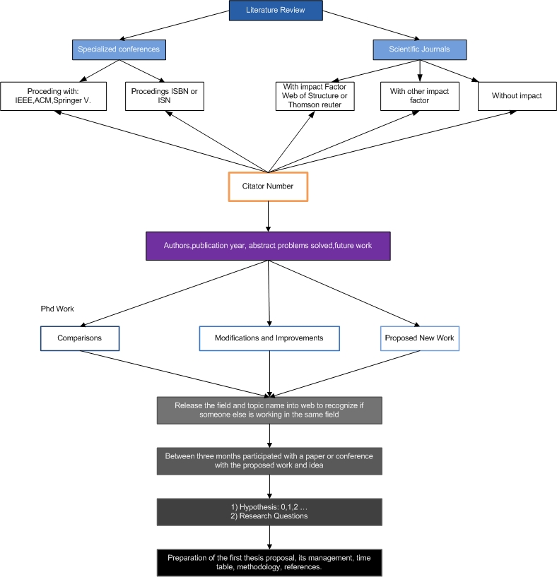
Flowchart of literature review process and topic selection

Slide 5
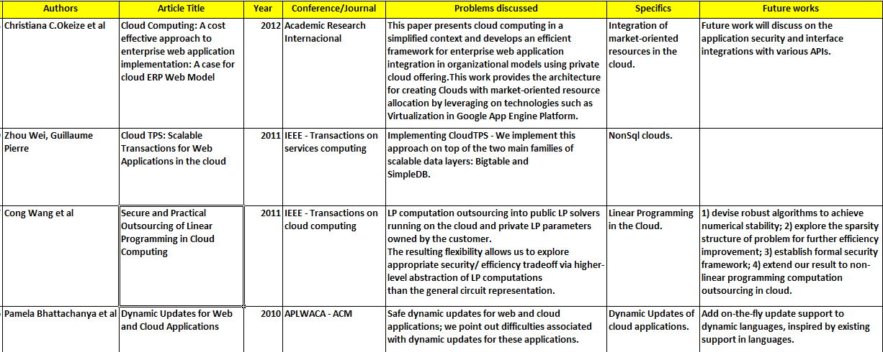
Example of generated list of targeted papers

Slide 6
Our Motivation
Try to help young researchers to see:
what are trending research areas at the moment
predict what might be relevant in the future
There are two problems we need to solve in this case:
be able to detect sections of research papers that describe the current and future work of the author
be able to extract entities

Slide 7
Methodology
Detection and extraction of relevant sections from research papers (future work, problem statement, etc)
Topic extraction using:
tf-idf, term frequency–inverse document frequency
Latent Dirichlet Allocation (LDA), finds sets of words within smaller topics of same text. Ex: cat and milk? Words that make sense are allocated into the same corpus.
Weighting results
By relevancy (e.g., impact factor, publisher)
By time dependant citation index
Notes:
In natural language processing, latent Dirichlet allocation (LDA) is a generative model that allows sets of observations to be explained by unobserved groups that explain why some parts of the data are similar. For example, if observations are words collected into documents, it posits that each document is a mixture of a small number of topics and that each word's creation is attributable to one of the document's topics
Most likely to participate set of words in a topic. Cat example with milk. And then distribution Dirichlet makes it allocated
Like: Hidden set of words that are distributed (Dirichlet) and allocated to topic.
f–idf means term-frequency times inverse document-frequency. tf–idf, short for term frequency–inverse document frequency, is a numerical statistic that is intended to reflect how important a word is to a document in a collection or corpus.^{[1]:8} It is often used as a weighting factor in information retrieval and text mining. The tf-idf value increases proportionally to the number of times a word appears in the document, but is offset by the frequency of the word in the corpus, which helps to control for the fact that some words are generally more common than others.
This is a originally a term weighting scheme developed for information retrieval (as a ranking function for search engines results), that has also found good use in document classification and clustering.

Slide 8
Anticipated results
Ability to better organize research papers
Offer complex search abilities to end users
Quickly recognize current and future research areas
Apply state of the art visualization techniques:
Flow diagrams
Network diagrams
A tool, plug-in, Web-App… ?

Slide 9
Horizon 2020 call
Call for developing governance for the advancement of Responsible Research and Innovation (H2020-GARRI-2014-1)
Topic: Scientific Information in the Digital Age: Text and Data Mining (TDM)
Deadline Date: 2014-10-02 +17:00:00

Slide 10
Call Specific Challenge
Text and Data Mining is the process of deriving information from machine-read material and is an essential feature in open science and innovation.
Building upon present knowledge is an important component of research that leads to new innovations.
TDM therefore has a huge potential for research and innovation and the economy as a whole.
Notes:
Coordination and support action

Slide 11
Conclusion
Not to re-invent the wheel!
Leads towards more qualitative thesis
Automatic Paper generation???
Possible funding opportunities
Open to your suggestions (and partnerships)

Slide 12
Thank You!
Asst. Prof. Dr. Adrian Besimi a.besimi@seeu.edu.mk
www.seeu.edu.mk

