Slide 1
A project management tool in Polytechnic University of Tirana (Bachelor thesis)
Iva Tarelli
Prof. Assoc. Elinda Kajo
14th Workshop “SEE&RE” Sinaia, Romania, 24-30 August 2014

Slide 2
Overview
Purpose
Actors & Functions
Development environment
Implementation
Usage
Application screenshots

Slide 3
Purpose
To organize the tasks of a project in a team
To coordinate the tasks of the project among team members
To inform the team leader about the progress of each task
To inform students about tasks’ deadlines and other events (meetings etc.)
To help students with 3 additional gadgets

Slide 4
Actors & Functions
Actors
Leader of the team
Member of the team
Some functions of the software
Create a new account, a new project or an event
Share tasks of a project
Modify projects, tasks and events
Remind the user for upcoming events, task’s and project’s deadlines.
Inform for the accomplishment of the task
Generate reports for the projects and events during a certain period

Slide 5
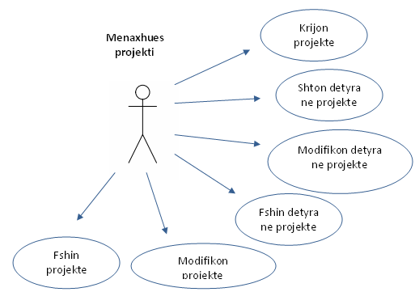
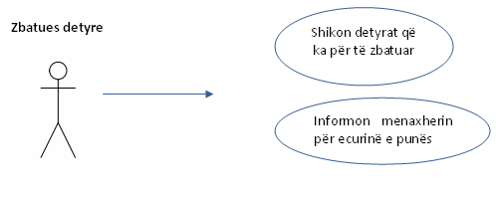
Use case diagrams
The same user can be both a team leader and a team member for two different teams

Slide 6
Design
JAVA- powerful object oriented language
- java version 1.7.0_40
Eclipse Standard/ SDK
- version Kepler Service Release 1
XAMMP (open source, popular and costless platform)
- Apache
- MySQL
JDBC- native protocol

Slide 7
Implementation
The source code is organized as follows:
- Default package: main class
- Database package: 13 classes that manipulate the database
- MenuPanels package: 21 classes for the graphic interface
- MainView package: 2 classes that create the main view of the application

Slide 8
Implementation (2)
Simple database in MySQL
4 tables: user, project, task, event
One user can have one-to-many projects
One user can have one-to-many tasks
One user can have one-to-many events
One project can have one-to-many tasks
Reports during a certain period can be generated, printed or saved as text documents

Slide 9
Usage
Lots of tests were made in localhost environment
Software installed in the PC-s in Computer Engineering Lab and used by the students in their projects
Other options will be added in the future based on students’ suggestions

Slide 10
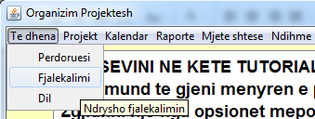
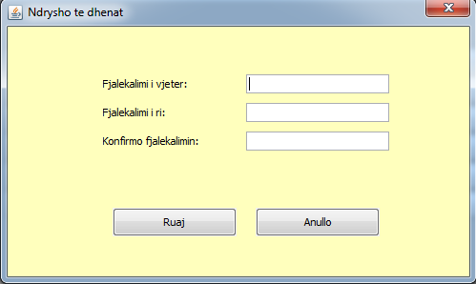
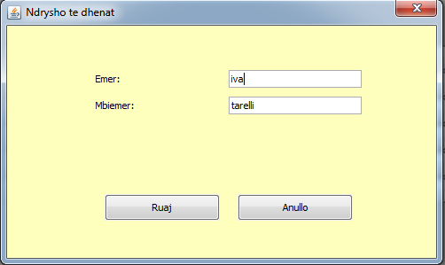
Menu option- “Data”

Slide 11
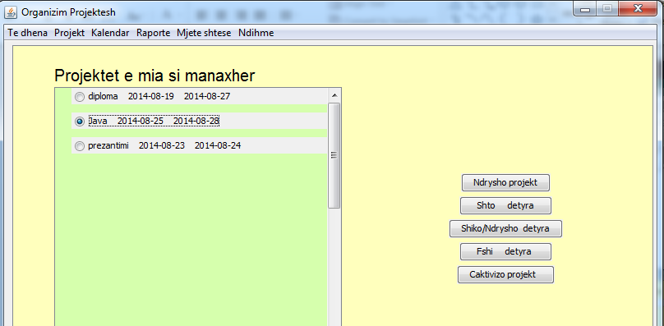
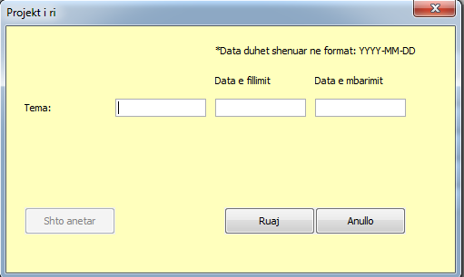
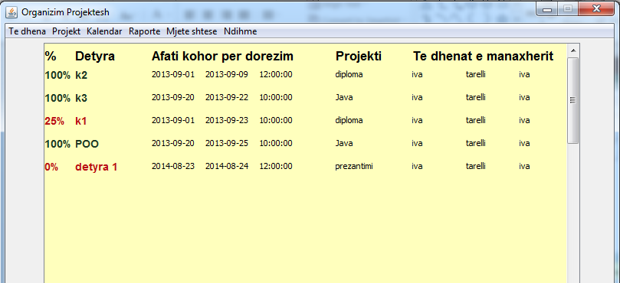
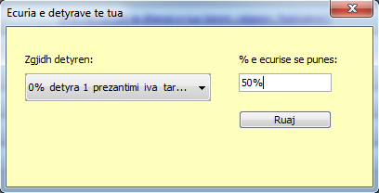
Menu option- “Project”

Slide 12
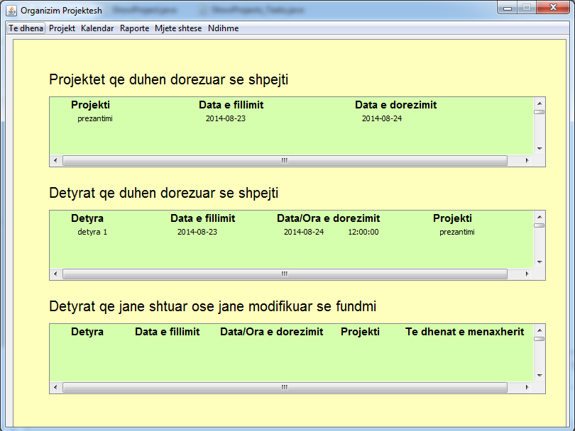
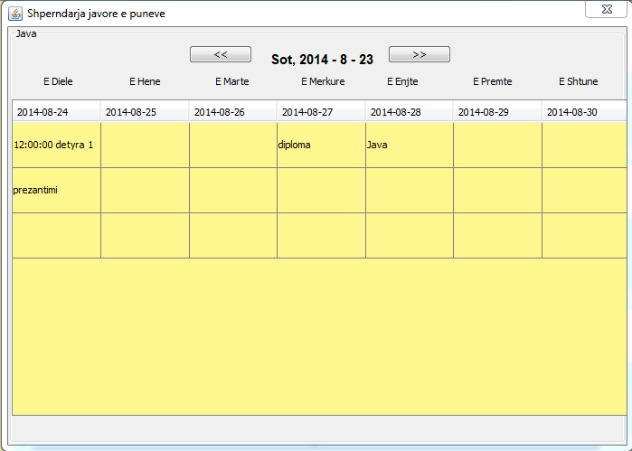
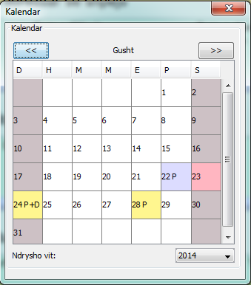
Menu option- ‘Calendar’

Slide 13
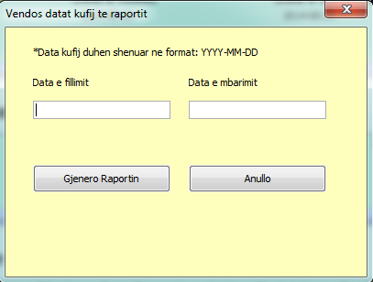
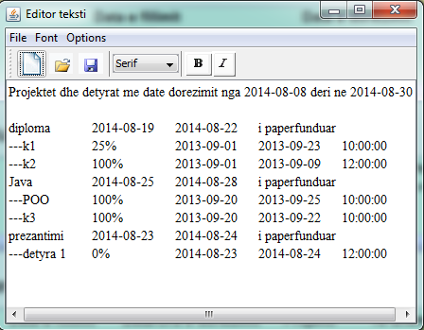
Menu option- “Report”

Slide 14
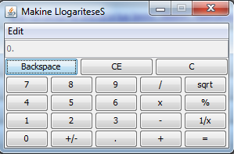
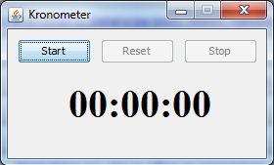
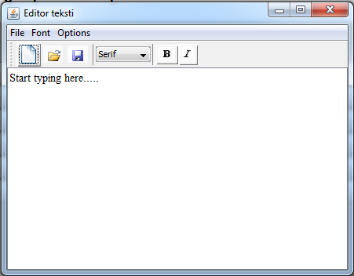
Menu option- “Additional gadgets”

Slide 15
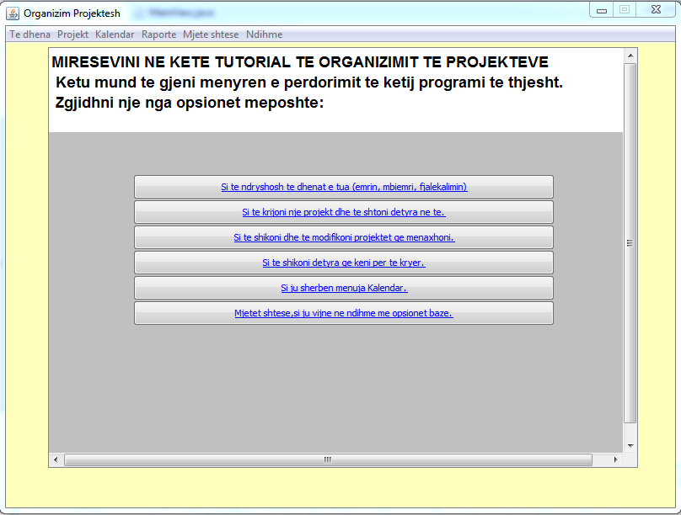
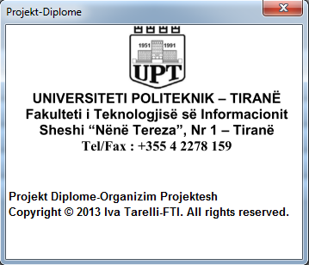
Menu option- “Help”

Slide 16
Conclusions
It was a real challenge to face up all the stages in software engineering from requirement analysis to testing and usage.
A combination of knowledge required to create this application. Except for programming and informatics, basic knowledge from project management was also important.
In the future, an interface may be implemented to access the application from smartphones and some other additional features.

Slide 17
Thank you for your attention!
Special thanks to Prof. Klaus Bothe, Dr. Zoran Putnik.

