Slide 1
Experiences with new master studies of Informatics at the University of Rijeka
Nataša Hoić-Božić, natasah@inf.uniri.hr
Patrizia Poščić, patrizia@inf.uniri.hr

Slide 2
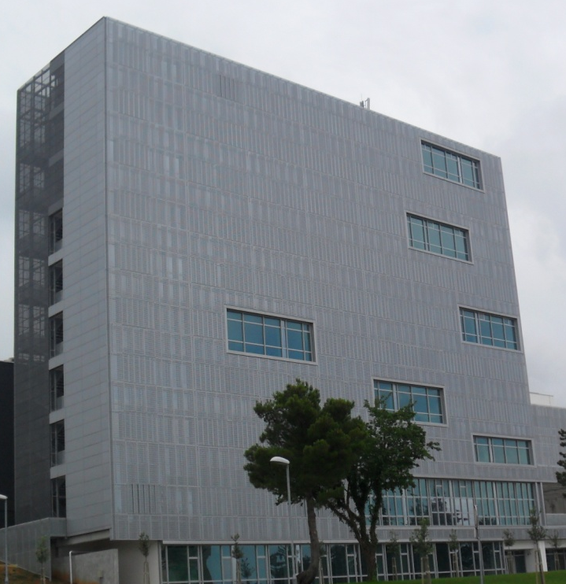
Odjel za informatiku, Sveučilište u Rijeci
Omladinska 14, 51000 Rijeka, Hrvatska
Tel.: + 385 51 345 034 Fax: + 385 51 345 207
Department of Informatics,
University of Rijeka
Omladinska 14,
51000 Rijeka, Croatia
http://www.inf.uniri.hr

Slide 3
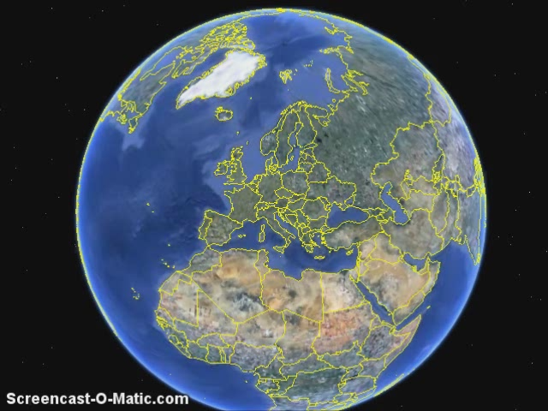
Department of Informatics at new University Campus

Slide 4
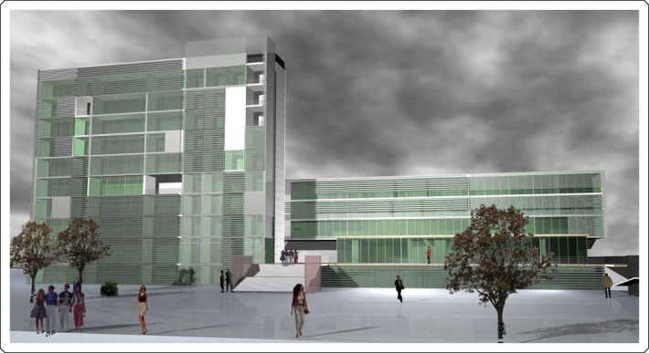
Study programs

Slide 5
Study programs
Undergraduate study of Informatics (Bachelor degree, 3 years,180 ECTS)
  Single major program of Informatics
  Double major program of Informatics and another major (in cooperation with FFRI)
Graduate study of Informatics (Master degree, 2 years, 120 ECTS
  Single major program of Informatics
    Teacher training (TT)
    Information and Communication Systems module (ICS)
    Business Informatics module (BI)
  Double major program of Informatics and another major
Ohrid
11th Workshop SE Education and Reverse Engineering
5
Notes:
5

Slide 6
Number of freshman students
Study program | Students | Foreign students
Undergraduate study of Informatics – single major | 60 | 5
Undergraduate study of Informatics – double major | 20 | 5
Graduate study of Informatics TT - single major | 20 | 0
Graduate study of Informatics TT - double major | 10 | 0
Graduate study of Informatics - ICS and BI | 26 | 4

Slide 7
BSC of Informatics: 1st Year of Study
Course name | ECTS | Hours | Core/Elective
Logics | 2 | 2 | CORE
Foregin Language 1 (English) | 4 | 2 | CORE
Physical Education 1 | 1 | 2 | CORE
Mathematics 1 | 5 | 4 | CORE
Physics 1 | 4 | 4 | CORE
Fundamentals of Informatics 1 | 5 | 4 | CORE
Programming 1 | 6 | 4 | CORE
Fundamentals of Digital Technique | 5 | 4 | CORE
Foregin Language 2 (English) | 4 | 2 | CORE
Physical Education 2 | 1 | 2 | CORE
Mathematics 2 | 5 | 4 | CORE
Physics 2 | 4 | 4 | CORE
Fundamentals of Informatics 2 | 5 | 4 | CORE
Programming 2 | 5 | 4 | CORE
Computer Architecture and Organization | 4 | 4 | CORE
Total Year 1 | 60
Ohrid
11th Workshop SE Education and Reverse Engineering
7
Notes:
7

Slide 8
BSC of Informatics: 2nd Year of Study
Course name | ECTS | Hours | Core/Elective
Foregin Language 3 (English) | 2 | 2 | CORE
Physical Education 3 | 1 | 2 | CORE
Mathematics 3 | 4 | 4 | CORE
Combinatorics | 5 | 4 | CORE
Computer Networks 1 | 5 | 4 | CORE
Operating Systems 1 | 4 | 4 | CORE
Introduction to Database | 5 | 4 | CORE
Information Systems | 4 | 4 | CORE
Foregin Language 4 (English) | 2 | 2 | CORE
Physical Education 4 | 1 | 2 | CORE
Discrete Mathematics | 5 | 4 | CORE
System Theory | 4 | 4 | CORE
Computer Networks 2 | 5 | 4 | CORE
Operating Systems 2 | 4 | 4 | CORE
Database | 4 | 4 | CORE
Alghorithms and data structures | 5 | 4 | CORE
Total Year 2 | 60
Ohrid
11th Workshop SE Education and Reverse Engineering
8
Notes:
8

Slide 9
BSC of Informatics: 3nd Year of Study
Course name | ECTS | Hours | Core/Elective
Numerical Mathematics | 5 | 4 | CORE
Dynamic Web Application 1 | 5 | 4 | CORE
Object Oriented Programming | 5 | 4 | CORE
Process Modeling | 5 | 4 | CORE
Formal Languages and Compilers 1 | 5 | 4 | CORE
Probability and Statistics | 5 | 4 | CORE
Dynamic Web Application 2 | 4 | 4 | CORE
Object Oriented Modeling | 5 | 4 | CORE
Multimedia Systems | 4 | 4 | CORE
Data Modeling | 5 | 4 | CORE
Final Exam | 2 | - | CORE
Elective segment: | 10
Introduction to Software Engineering | 5 | 4 | ELECTIVE
Information Theory | 5 | 4 | ELECTIVE
Formal Languages and Compilers 2 | 5 | 4 | ELECTIVE
Logical Programming | 5 | 4 | ELECTIVE
Total Year 3 | 60
Ohrid
11th Workshop SE Education and Reverse Engineering
9
Notes:
9

Slide 10
Master of Education of Informatics: 1st Year of Study (or 4th Year)
Course name | ECTS | Hours | Core/Elective
Intelligent Systems 1 | 5 | 4 | CORE
Operations Research 1 | 5 | 4 | CORE
Teacher courses
Hypermedia Supported Education 1 | 5 | 3 | CORE
Development Psychology | 5 | 3 | CORE
Educational Psychology 1 | 5 | 3 | CORE
Elective Course: | 5
Knowledge Discovery and Data Mining | 5 | 4 | ELECTIVE
Object-Oriented Programming Languages | 5 | 4 | ELECTIVE
Intelligent Systems 2 | 5 | 4 | CORE
Operations Research 2 | 5 | 4 | CORE
Teacher courses
Hypermedia Supported Education 2 | 6 | 3 | CORE
Educational Psychology 2 | 4 | 3 | CORE
General Pedagogy | 5 | 3 | CORE
Didactics 1 | 5 | 3 | CORE
Total: | 60 (30 for teacher courses)
Ohrid
11th Workshop SE Education and Reverse Engineering
10
Notes:
10

Slide 11
Master of Education of Informatics: 2nd Year of Study (or 5th Year)
Course name | ECTS | Hours | Core/Elective
Human-Machine Communication | 5 | 4 | CORE
Teacher courses
Teaching Methods of Informatics 1 | 6 | 4 | CORE
Didactics 2 | 4 | 3 | CORE
Sociology of Education | 3 | 2 | CORE
Teaching Children with special needs | 3 | 3 | CORE
Elective Course: | 9
Organization’s Information System | 4 | 4 | ELECTIVE
Decision Support Systems | 5 | 4 | ELECTIVE
Information Technology Project Management | 5 | 4 | ELECTIVE
Distributed Systems | 5 | 4 | ELECTIVE
Information Technology and Society | 5 | 4 | CORE
Master’s Thesis Seminar | 4 | 2 | CORE
Thesis | 5 |  | CORE
Teacher courses
Teaching Methods of Informatics 2 | 6 | 4 | CORE
Design of Educational Systems | 6 | 4 | CORE
Teaching Practice | 4 |  | CORE
Total: | 60 (32 for teacher courses)
Ohrid
11th Workshop SE Education and Reverse Engineering
11
Notes:
11

Slide 12
Master of Informatics: 1st Year of Study (or 4th Year)
Course name | ECTS | Hours | Core/Elective
Intelligent Systems 1 | 6 | 4 | CORE
Operations Research 1 | 6 | 4 | CORE
Program BI
Software Engineering | 6 | 4 | CORE
Business Economics | 6 | 4 | CORE
Elective Course (one from ICS program) | 6
Program ICS
Distributed Systems | 6 | 4 | CORE
Object-Oriented Programming Languages | 6 | 4 | CORE
Elective Course (one from BI program) | 6
Intelligent Systems 2 | 6 | 4 | CORE
Operations Research 2 | 6 | 4 | CORE
Program BI
Selected Topics in Databases | 6 | 4 | CORE
Electronic Commerce | 6 | 4 | CORE
Elective Course (one from ICS program) | 6
Program ICS
Multimedia and Hypermedia Systems | 6 | 4 | CORE
Digital Signal Processing | 6 | 4 | CORE
Elective Course (one from BI program) | 6
Ohrid
11th Workshop SE Education and Reverse Engineering
12
Notes:
12

Slide 13
Master of Informatics: ^{2nd} Year of Study (or 5th Year) – winter semestar
Course name | ECTS | Hours | Core
Communication Skills | 2 | 2 | CORE
Master’s Thesis Seminar | 4 | 2 | CORE
Program BI
Management and Leadership | 6 | 4 | CORE
Information Technology Project Management | 6 | 4 | CORE
Elective Course (two from ICS program or common courses) | 12
Program ICS
Network Systems Management | 6 | 4 | CORE
Human-Machine Communication | 6 | 4 | CORE
Knowledge Management | 6 | 4 | CORE
Elective Course (one from BI program or common courses) | 6
Common courses
Knowledge Discovery and Data Mining | 6 | 4 | ELECTIVE
Organization’s Information System | 6 | 4 | ELECTIVE
Ohrid
11th Workshop SE Education and Reverse Engineering
13
Notes:
13

Slide 14
Master of Informatics: ^{2nd} Year of Study (or 5th Year) – summer semestar
Course name | ECTS | Hours | Core
Information Technology and Society | 5 | 4 | CORE
Thesis | 10 |  | CORE
Program BI
Strategic Planning of Information Systems | 5 | 4 | CORE
Logistics | 5 | 4 | CORE
Elective Course (one from ICS program or common course) | 5
Program ICS
Decision Support Systems | 5 | 4 | CORE
Natural Language Processing | 5 | 4 | CORE
Elective Course (one from BI program or common course) | 5
Common course
E-learning | 5 | 4 | ELECTIVE
Ohrid
11th Workshop SE Education and Reverse Engineering
14
Notes:
14

Slide 15
Professional or academic degree obtained upon completion of the study
Master of Informatics Specialist in Business Informatics (BI)
Master of Informatics Specialist in Information and Communication Systems (ICS)
Ohrid
11th Workshop SE Education and Reverse Engineering
15
Notes:
15

Slide 16
Competences acquired by students upon completion of the study
Master of Informatics Specialist in Business Informatics is:
  capable of projecting and developing software and information-communication solutions for business systems, civil companies, state institutions and economic sector
  a leading expert in the field of business applications, decision support systems, information technology project management, etc.
Master of Informatics Specialist in Information and Communication Systems is:
  capable of designing, developing and maintaining information and computer systems, doing system administration and oversight activities (servers, information systems, databases)
  a leading expert in the field of computer systems, computer networks, and information-communication technology
Ohrid
11th Workshop SE Education and Reverse Engineering
16
Notes:
16

Slide 17
Cooperation with IT companies
Collaboration with several small and medium-sized companies in IT sector (in our county) where our students can do their research for diploma thesis
After finishing the study many students get a job in those companies
In June 2011 American company iOLAP opened the office in Rijeka and announced the bidding for jobs
Some of our students get the job
Ohrid
11th Workshop SE Education and Reverse Engineering
17
Notes:
17

Slide 18
18
Notes:
18

Slide 19
Diploma thesis
In July 2011 the first student had oral examination and became Master of Informatics Specialist in Information and Communication Systems
  Title of the thesis: Wireless Encryption
Ohrid
11th Workshop SE Education and Reverse Engineering
19
Notes:
19

Slide 20
Plans for improvements of the master studies and for establishing a PhD study
Proposal of new postgraduate doctoral study program “Informatics”
Interdisciplinary research in the field of social (information sciences) and technical (computer sciences) sciences
Two modules:
  Information Systems and
  Intelligent Computing Systems
Opportunity to choose elective subjects from both modules
Ohrid
11th Workshop SE Education and Reverse Engineering
20
Notes:
20

Slide 21
Possibilities for exchanging the students (Erasmus)
All courses are one-semester courses according to Bologna
  Students can participate in mobility and exchange programs at different universities (domestic and / or international) at any stage of their studies
Erasmus cooperation at the master level of study
  3 students were involved this academic year in ERASMUS exchange program at the Karl-Franzens University in Graz, Austria for one semester and were very satisfied with the experience
  Next year three of our students will go to the same university
Possibility to accept foreign students from the next academic year
Ohrid
11th Workshop SE Education and Reverse Engineering
21
Notes:
21

Slide 22
Possible cooperation with SEE countries
Exchanging the students and teachers (Erasmus)
Undergraduate and graduate studies of Informatics for foreign students
Research projects
…

Slide 23

Thank you for your attention!
www.inf.uniri.hr
Nataša Hoić-Božić,
natasah@inf.uniri.hr
Patrizia Poščić, patrizia@inf.uniri.hr

