Slide 1
Learning by DeLC education portal
One year experience
Emil Doychev, Vesselina Valkanova
University of Plovdiv, Bulgaria
Ohrid, 25.08.2011

Slide 2
Custom DeLC Features
Custom functionality after the 1st year
  Evolved Exam System
  Event driven reminder system
  Student book
  Lecturer book
  Resource Library
  Own SCORM Engine (development in progress)

Slide 3
DeLC Subsytems
DeLC
Exams Engine
Reminders Engine
SCORM Engine
Agent-oriented Assessment
Presented the last year
Separate talk by Vladimir
Under development
Covered by prof. Stoyanov in separate talk

Slide 4
Current Stats
Current stats for the exams digital library:
Student accounts: 127
Questions | 319
Tests/Exams | 13
Subjects | 10
Generated Tests/Exams | 360

Slide 5
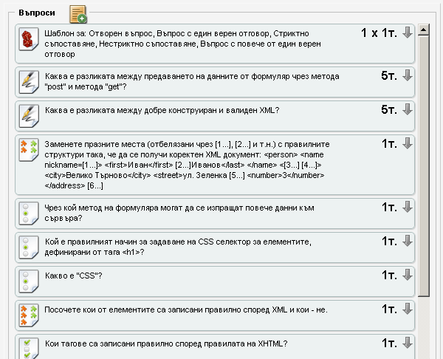
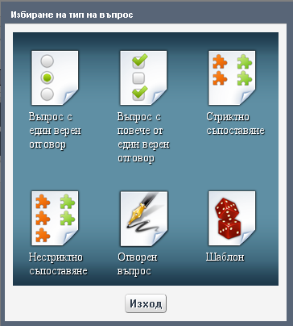

Creating a test
Library with questions and templates
DeLC Server
1. Create questions
2. Create templates
3. Create test
Q1
Q2
Q3
Q4
Q5
Qn
Different types of questions
T1
The template dynamically selects a set of questions, based on criteria set by the lecturer
The test consists of a set of questions and set of templates
Template1
Lecturer
Test
T2
T3
Tn

Slide 6
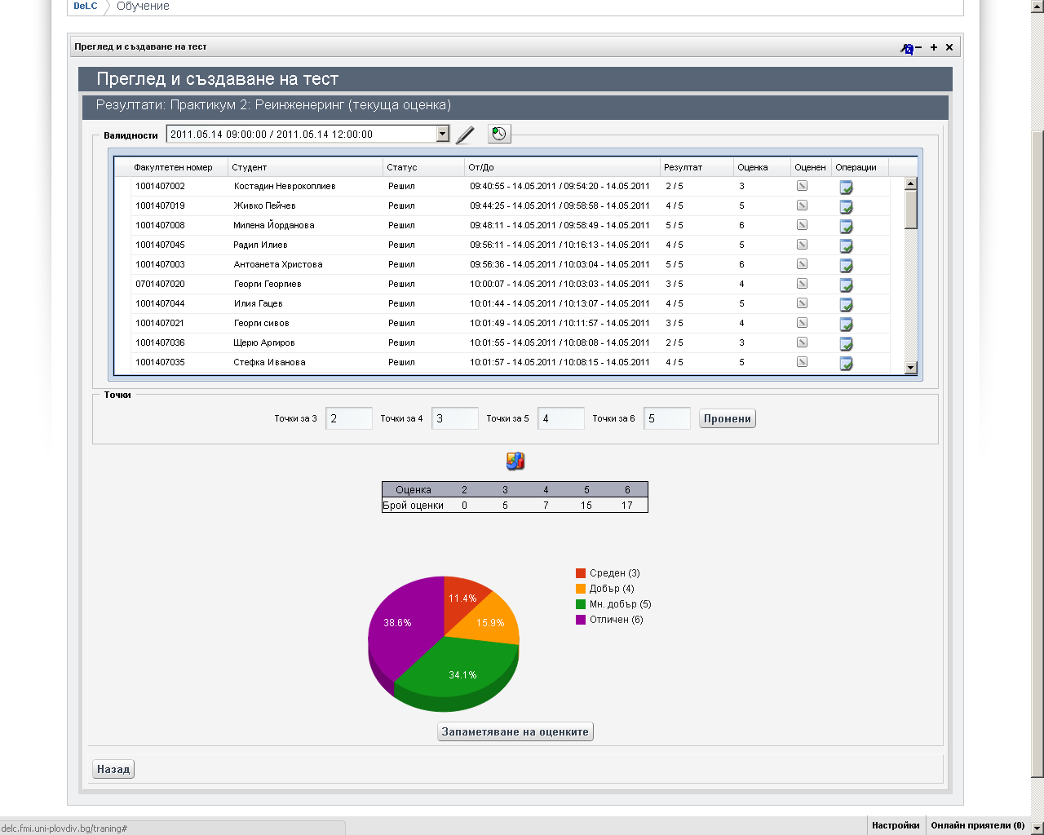

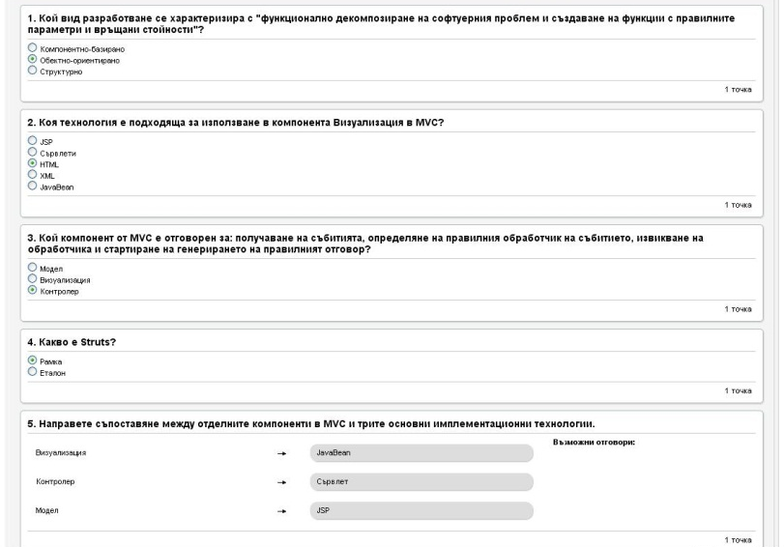

Carrying out an exam
If there are open questions the student will be able to see his/her rating after the evaluation of these questions.
The time counting is personal per student
Student 1
Student 2
Student n+1
Student 3
Student n+2
Student 4
Student n
Variant 1
Variant 2
Result
Result
Variant 3
Result
Variant n
Variant X
Variant n+1
Variant 4
Optimizing the time for the whole exam – the free working places can be used immediately by another students.
For each student a different test is generated, based on the templates included in the test.
Currently a system for automatic assessment is developing (agent oriented).
When the student complete its exam and if there are no open questions he/she receive immediately his/her result.
DeLC Server
Another possibility – the lecturer make assessment of the open questions.
It is possible to carry out different exams in the same time.
Lecturer
Test
System for automatic
assessment of open questions
Test 2

Slide 7
Resource Library
Contains set of resources:
  documents
  images
  Archives
  …
Hierarchical organization
Strong and detailed access control:
  by user, group, role
  per branch or individual resource
Possibility for the students to upload resources

Slide 8
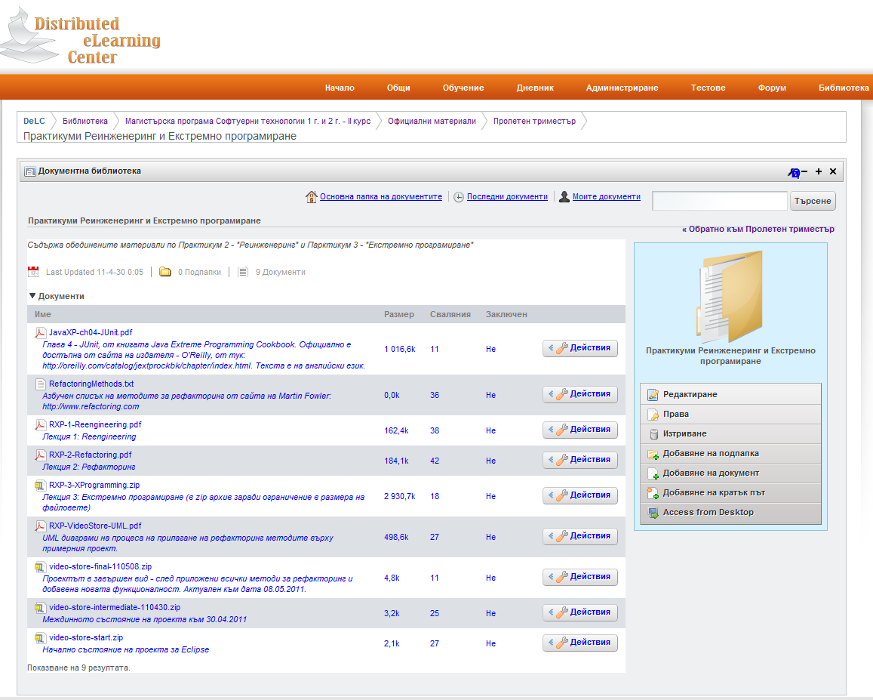
Resource Library

Slide 9
User Profiles and Personalization
The problems:
  Big amount of user profiles to maintain
  Some kind of fraud protection
The solution:
  Use an secure LDAP server and the ability of the portal framework for automatic profile creation

Slide 10
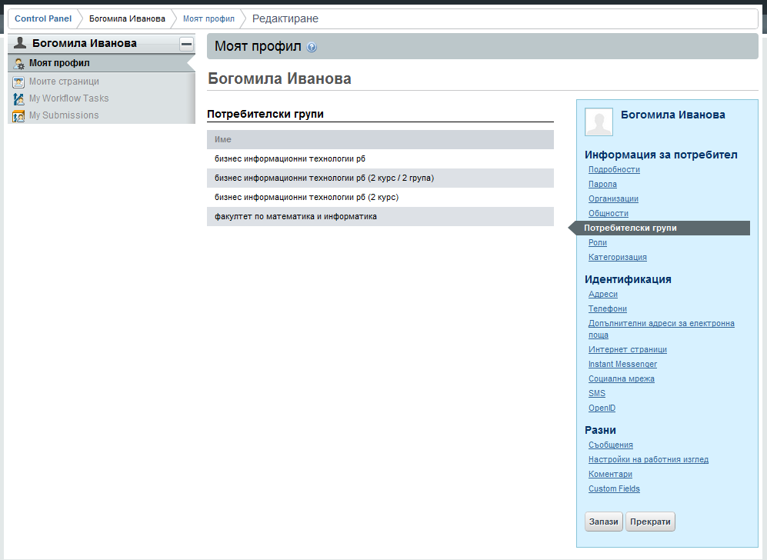
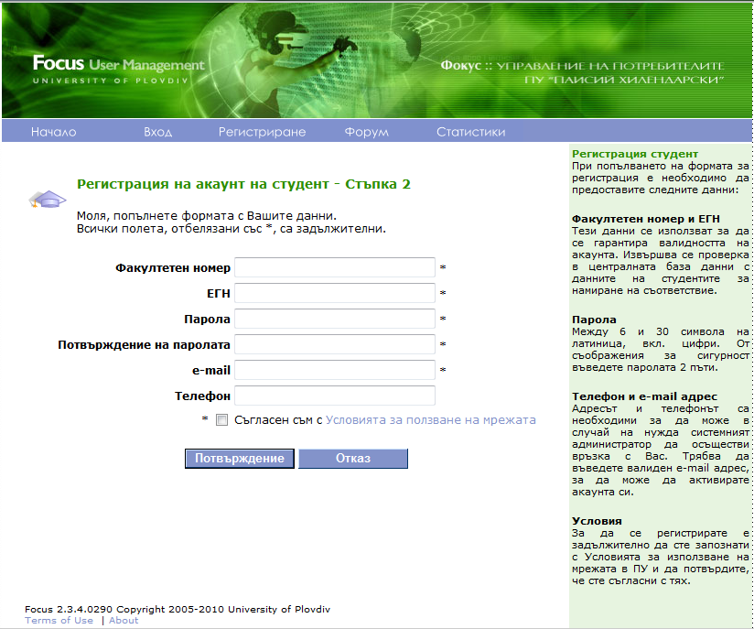
User Profiles and Personalization
An information system supported by the university staff
LDAP synchronization - at most 5 seconds after change in Focus DB
A web based system for user account management
DeLC uses Focus LDAP to get user credentials along with its role and groups (at each login)
Daily synchronization for the existing student accounts

Slide 11
Final thoughts
About the students:
  They likes:
    the ability to see their exam assessment online ASAP
    the impossibility anybody else to see their assessment
    the easy way for sharing materials trough the resource library
  They are trying to cheat during the exams.
About the lecturers:
  They likes:
    the dynamic nature of the tests
    the flexible way for fine tuning the exams assessment
    the resource library
    …

